Slide 1
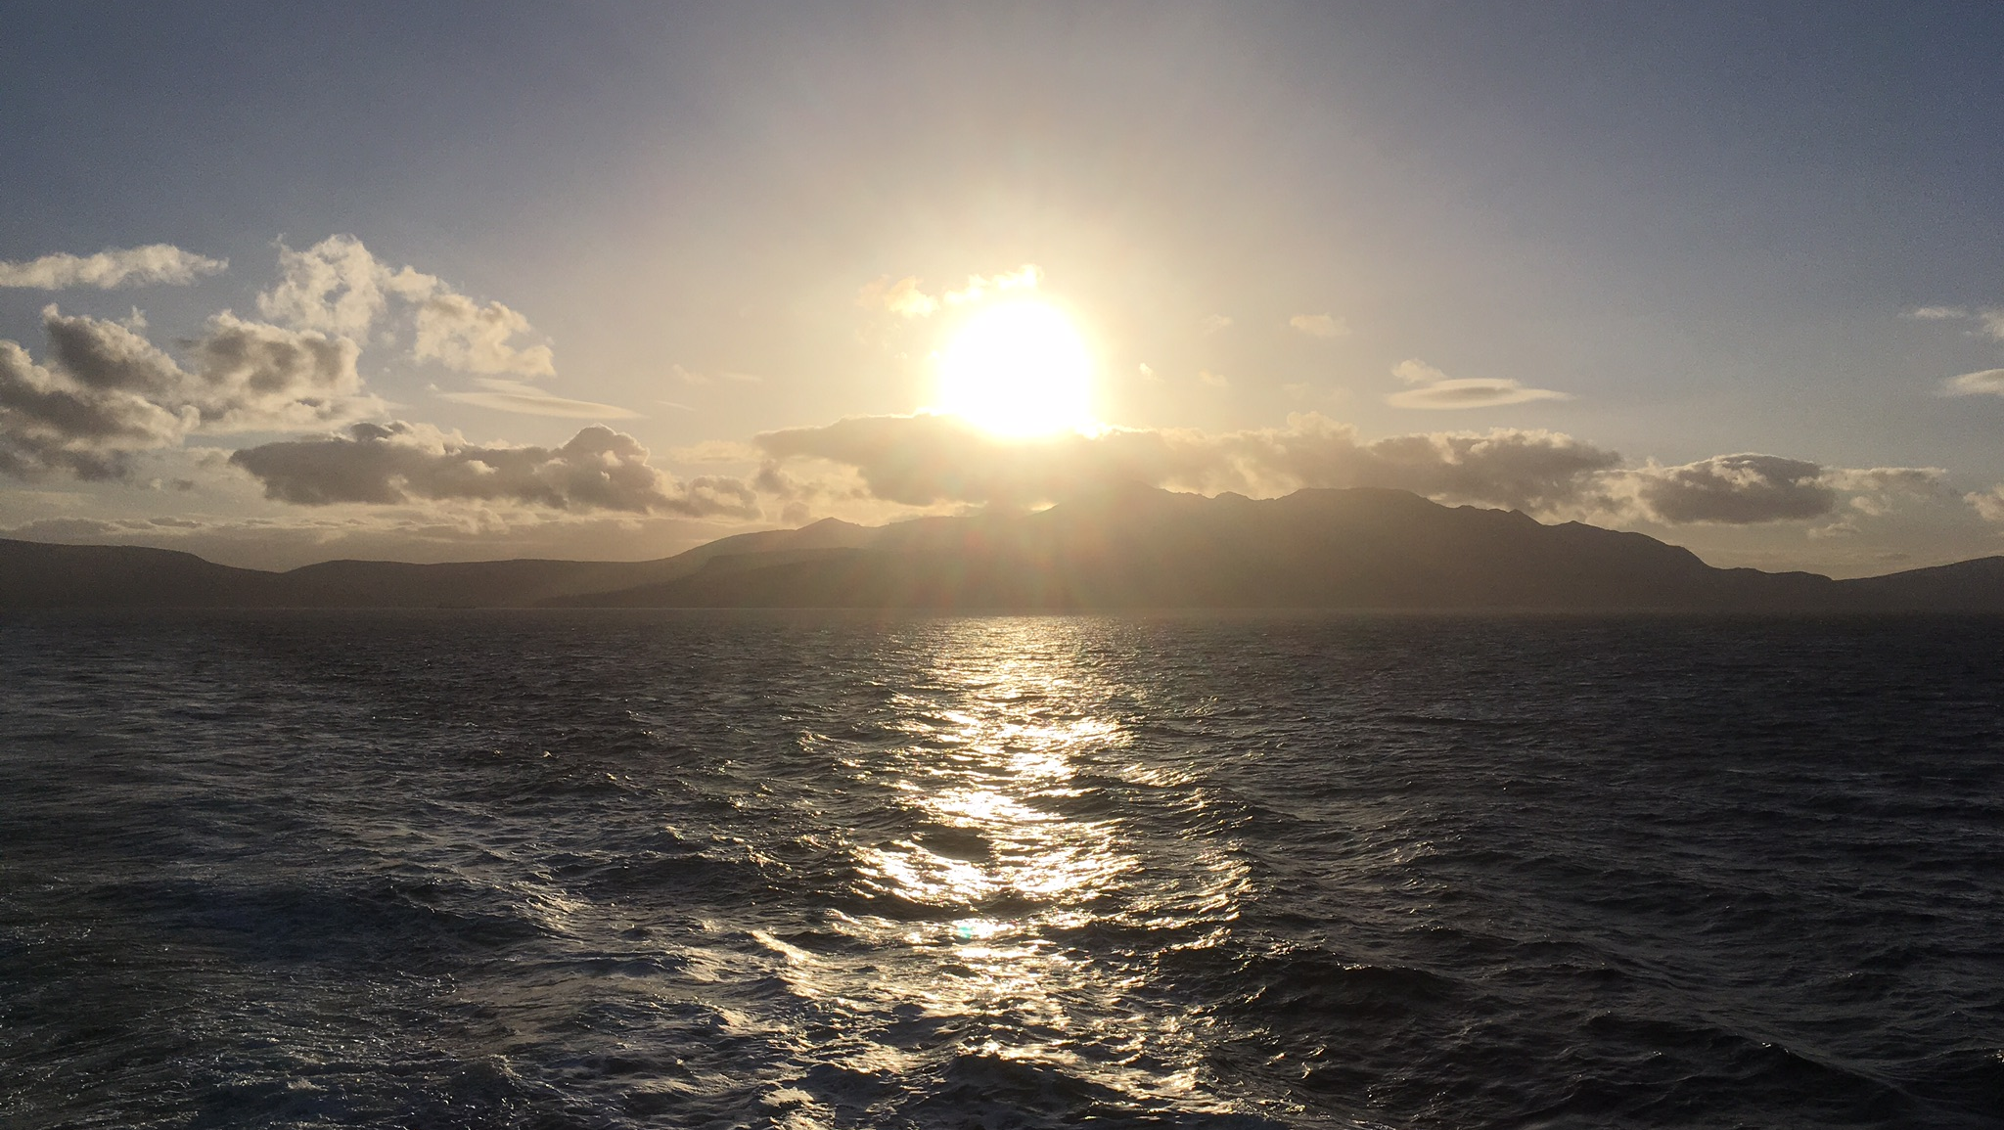
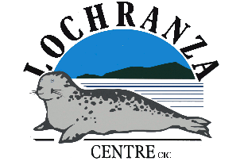
Over sea but not overseas
Lochranza Centre CIC
Isle of Arran

Slide 2
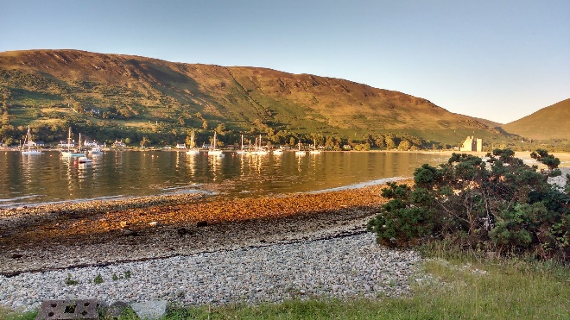
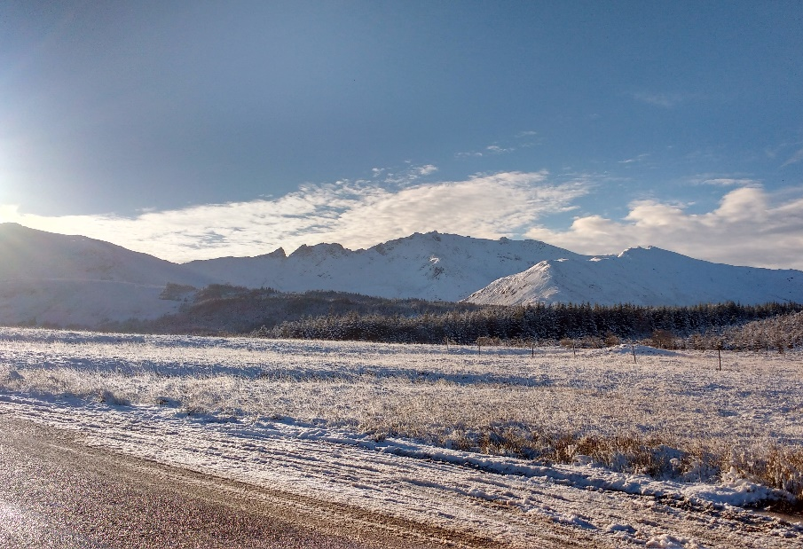
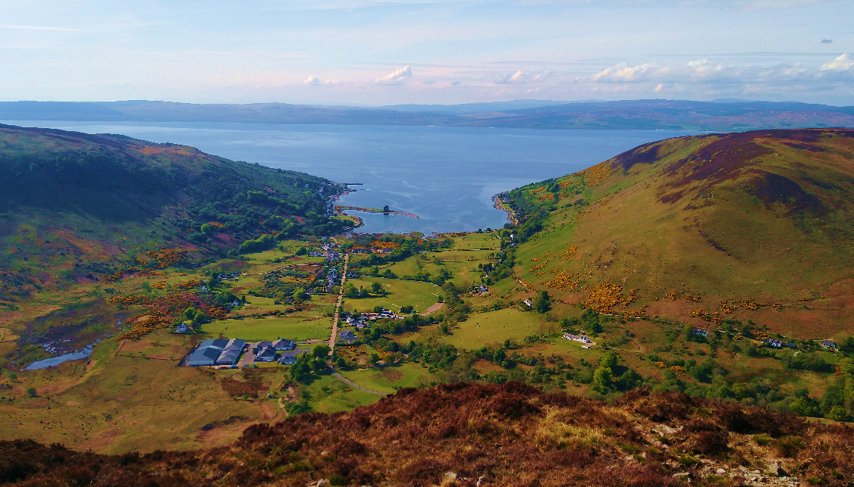
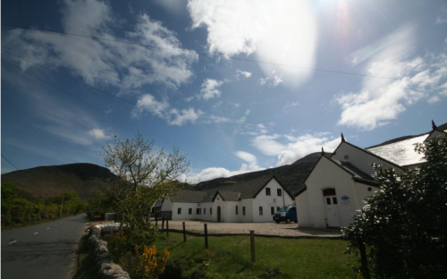
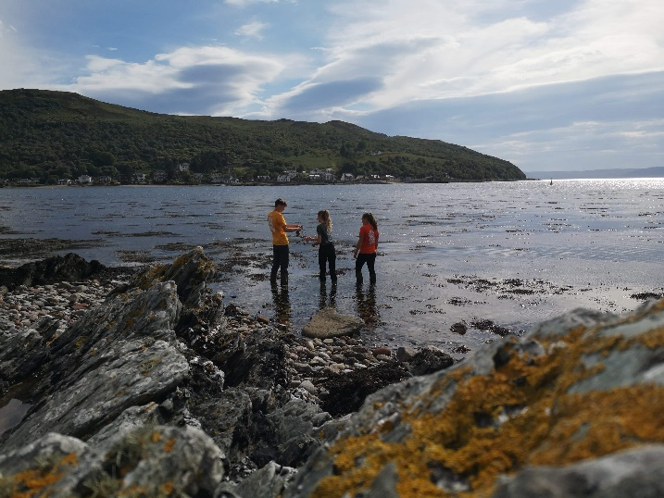
Take the ferry across from the mainland…
drive north past the jagged granite mountains
dodge the stags and the sheep roaming the road
and you’ll reach the quiet village of Lochranza
home to the Lochranza Centre Community Interest Company
provider of outdoor education and activities on the spectacular Isle of Arran
and “one of the best locations for fieldwork in Europe”

Slide 3
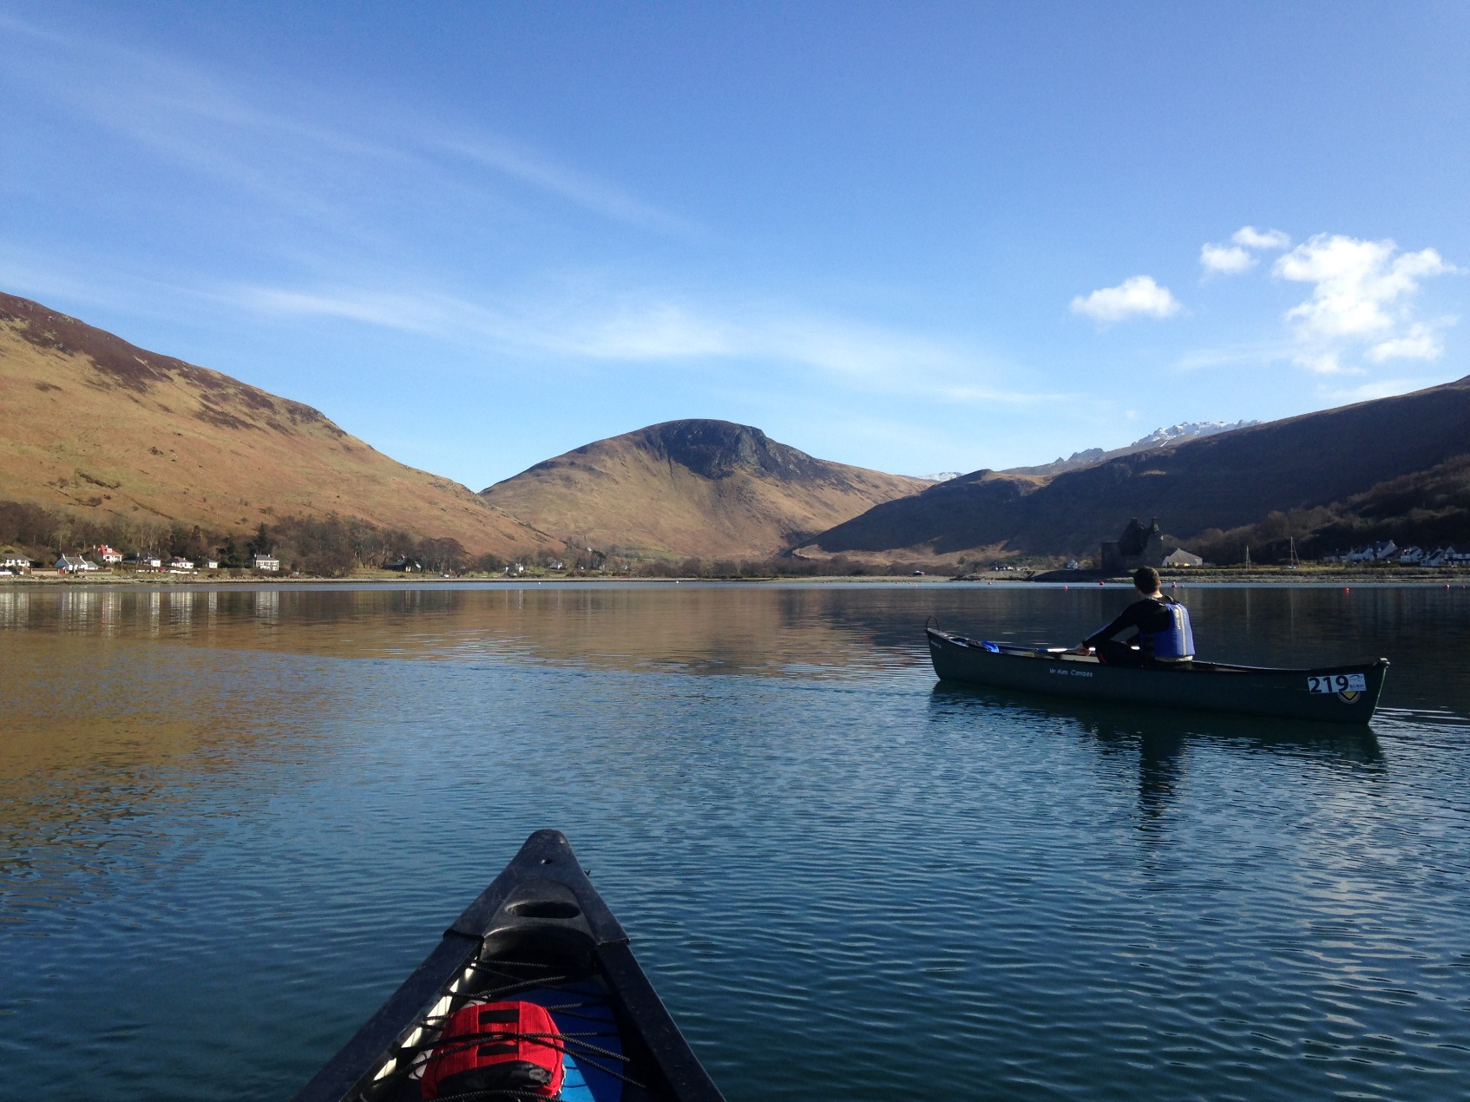
Lochranza Centre CIC
A third sector organisation
guided by the UNESCO principles of education, conservation and sustainability

Slide 4
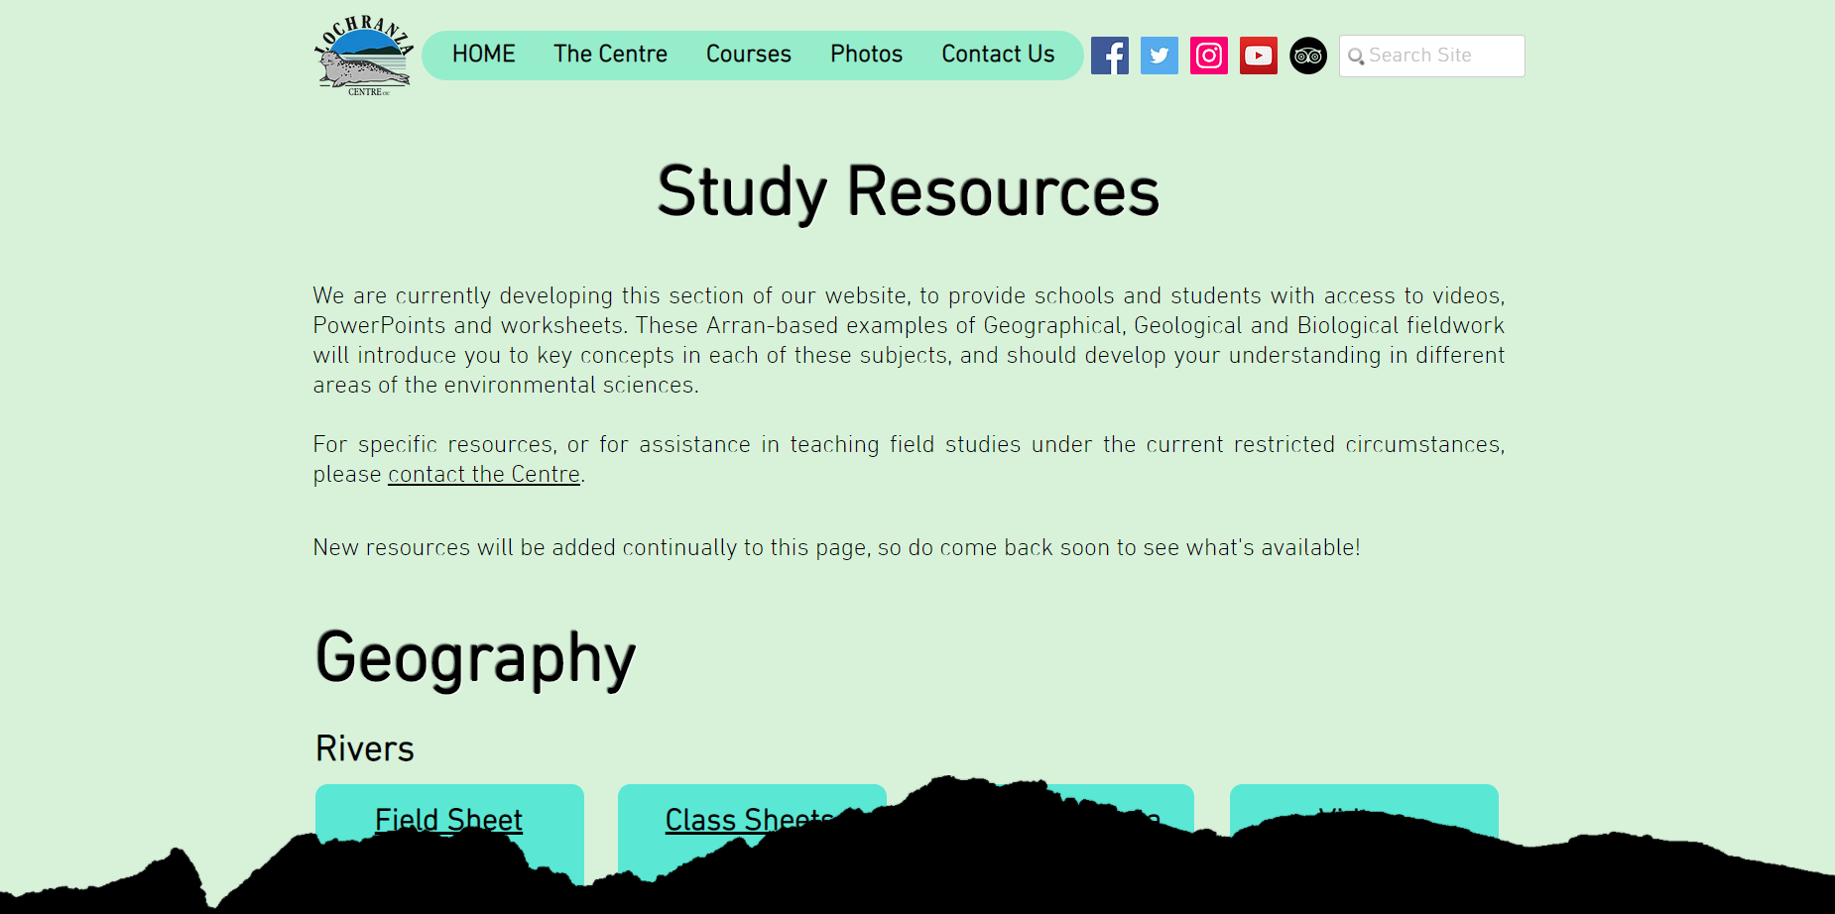
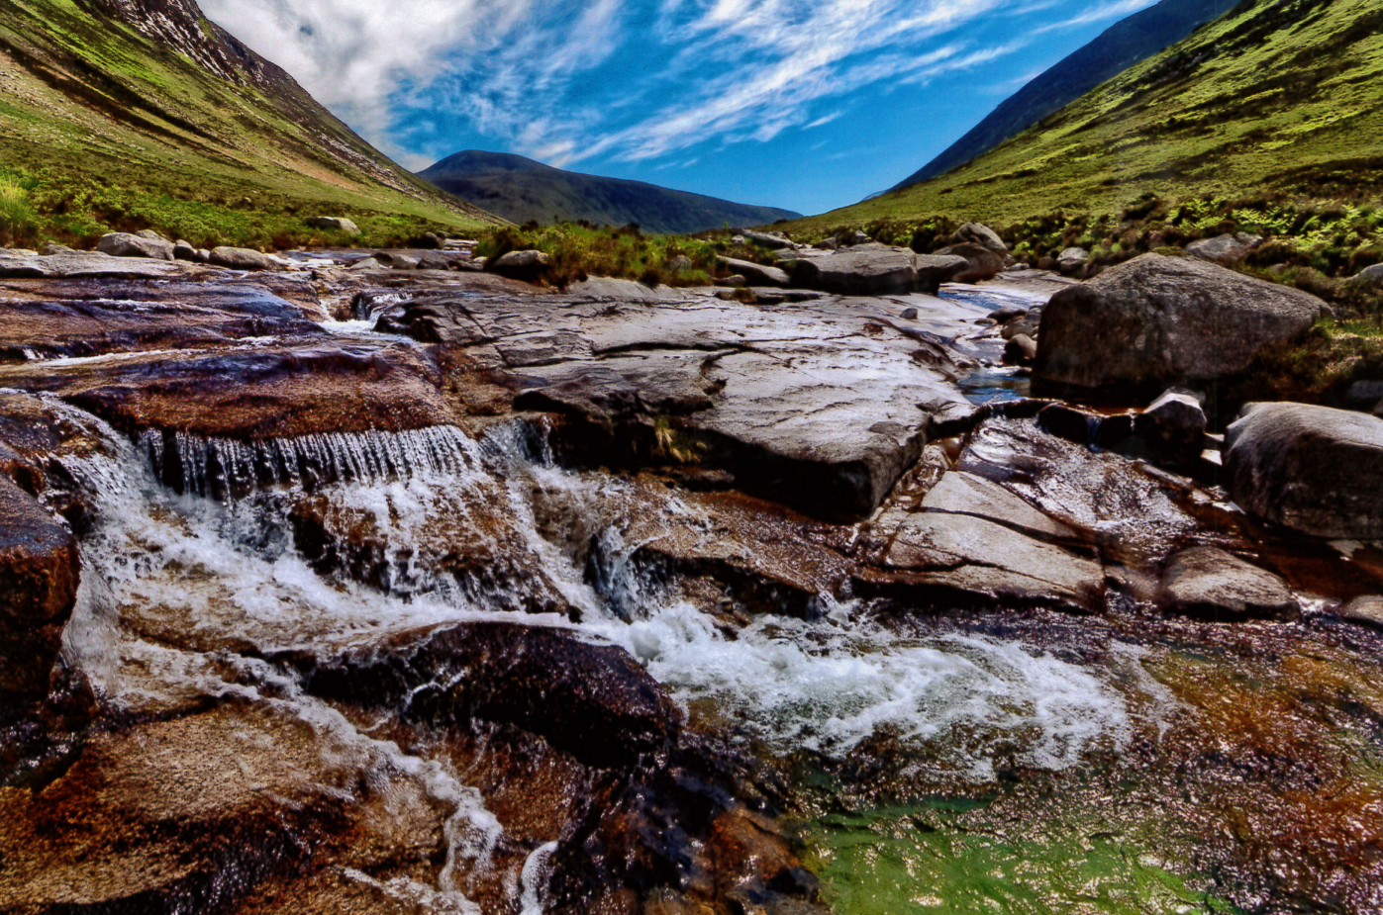
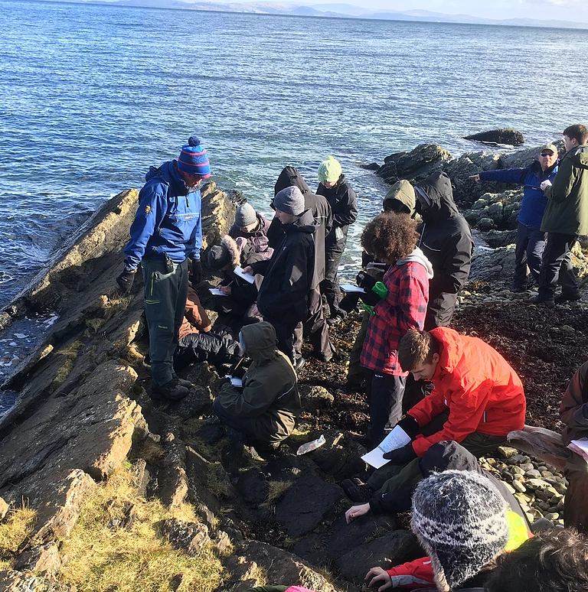
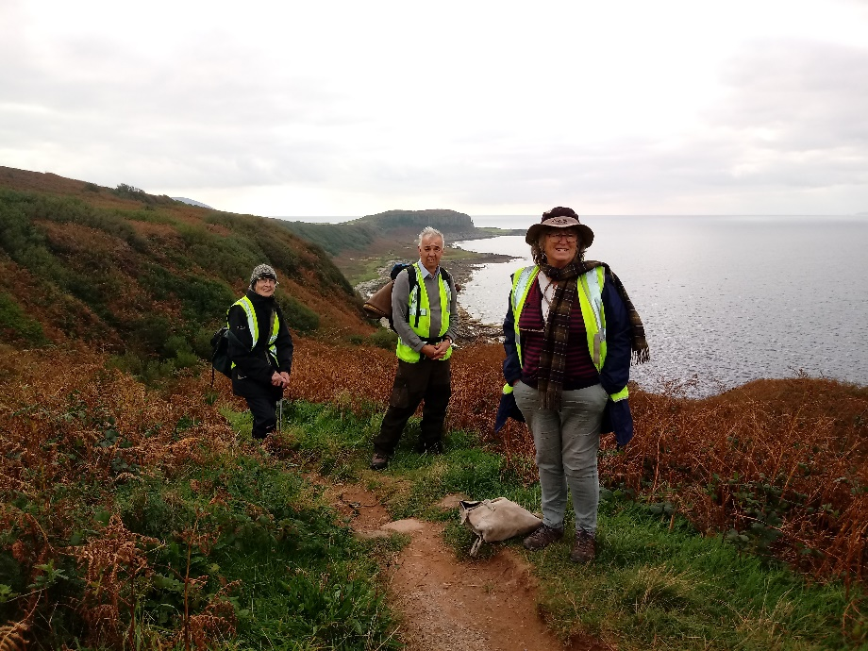
Education
Free online study resources, in geography, geology and biology
Interpretation, talks and guided walks on Arran’s geology available to the general public
Residential fieldtrips, teaching groups of all ages – from primary schools to Advanced Higher/A Level students to members of the University of the Third Age

Slide 5
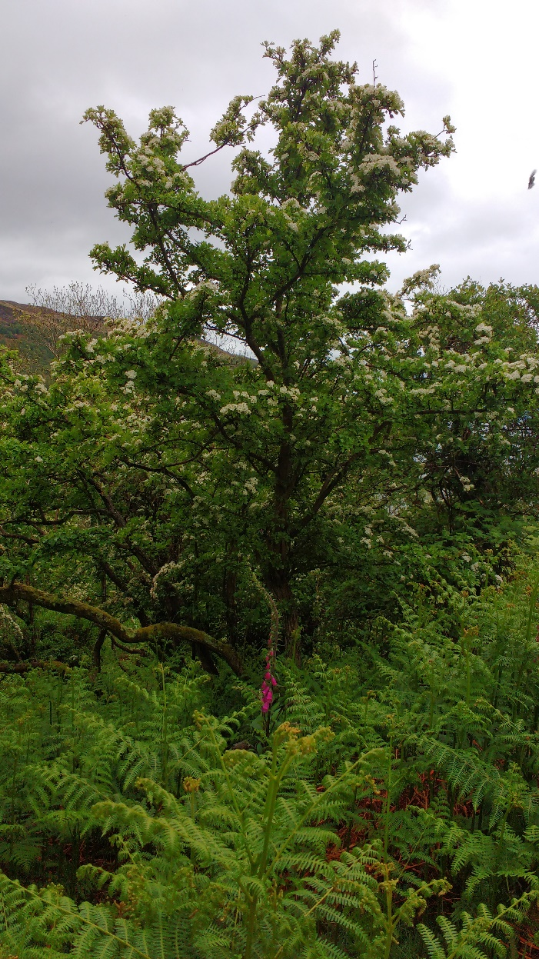
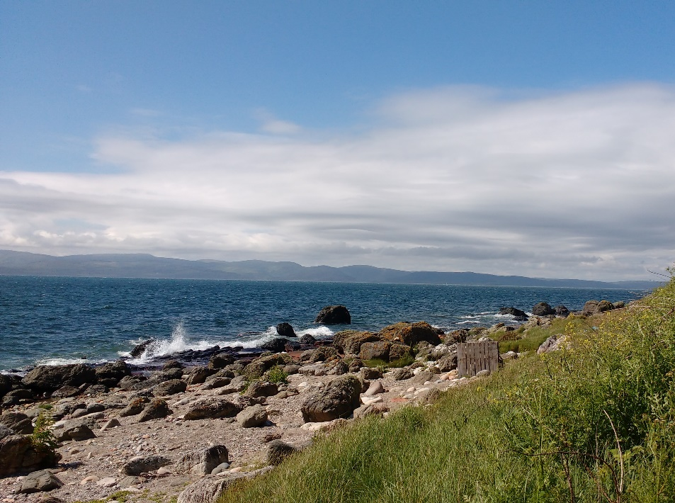
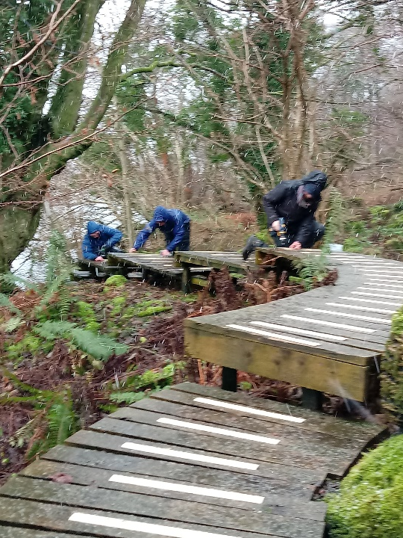
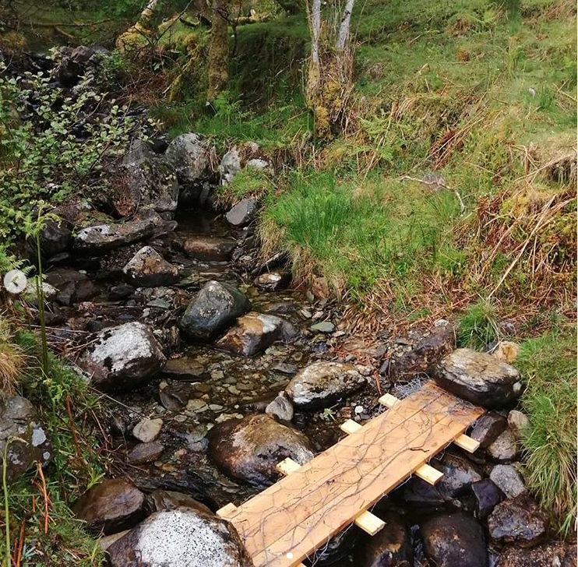
Conservation
Beach cleans
Footpath construction and maintenance
Vegetation management around Lochranza

Slide 6
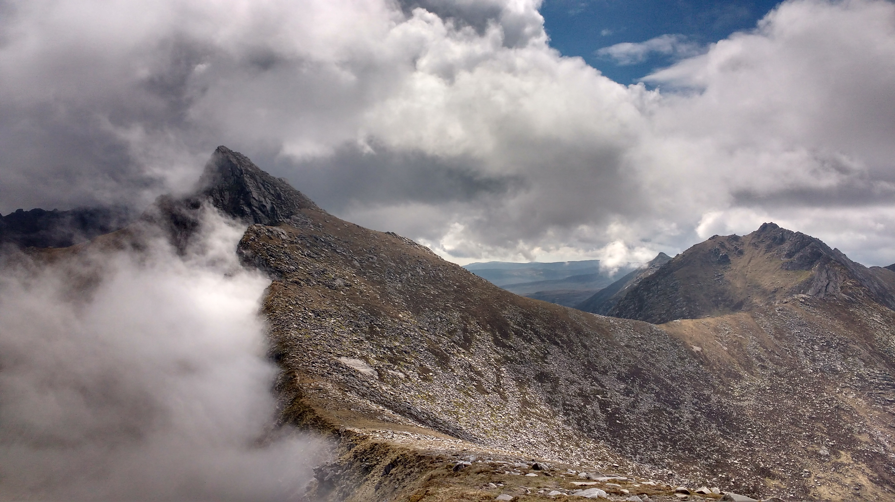
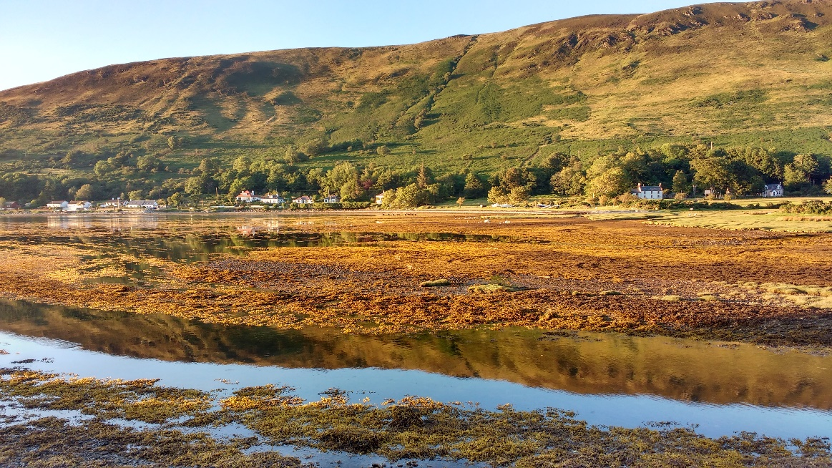
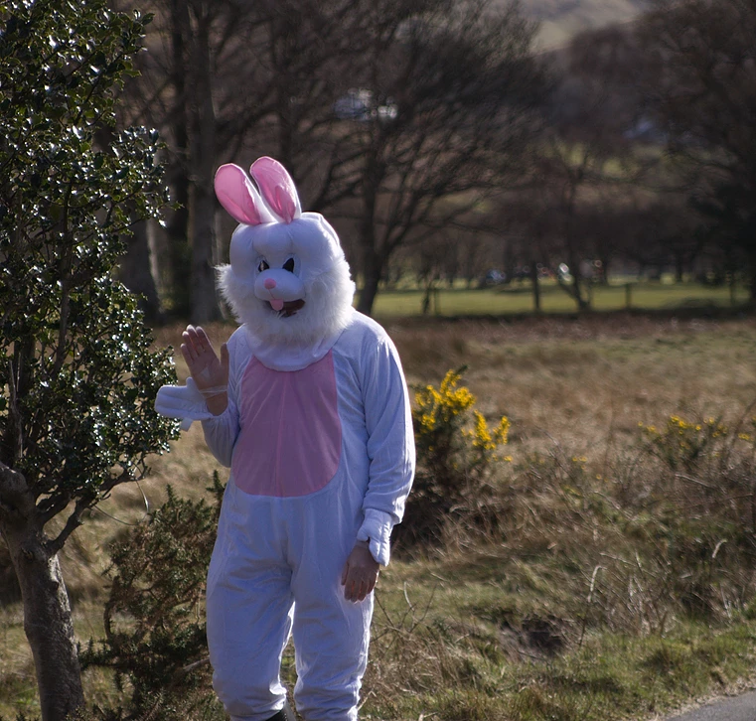
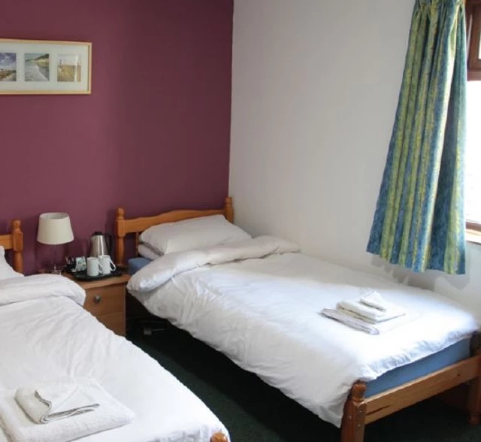
Sustainability
Helping out at local events, such as the Arran Mountain Festival
Acting as a base to support the remote and rural local community
Providing last-minute accommodation during ferry crises!
And running events to keep all the family entertained…
Notes:
Community stuff – remote and rural island community, parties, ferry crises, easter bunny - photoboard

Slide 7
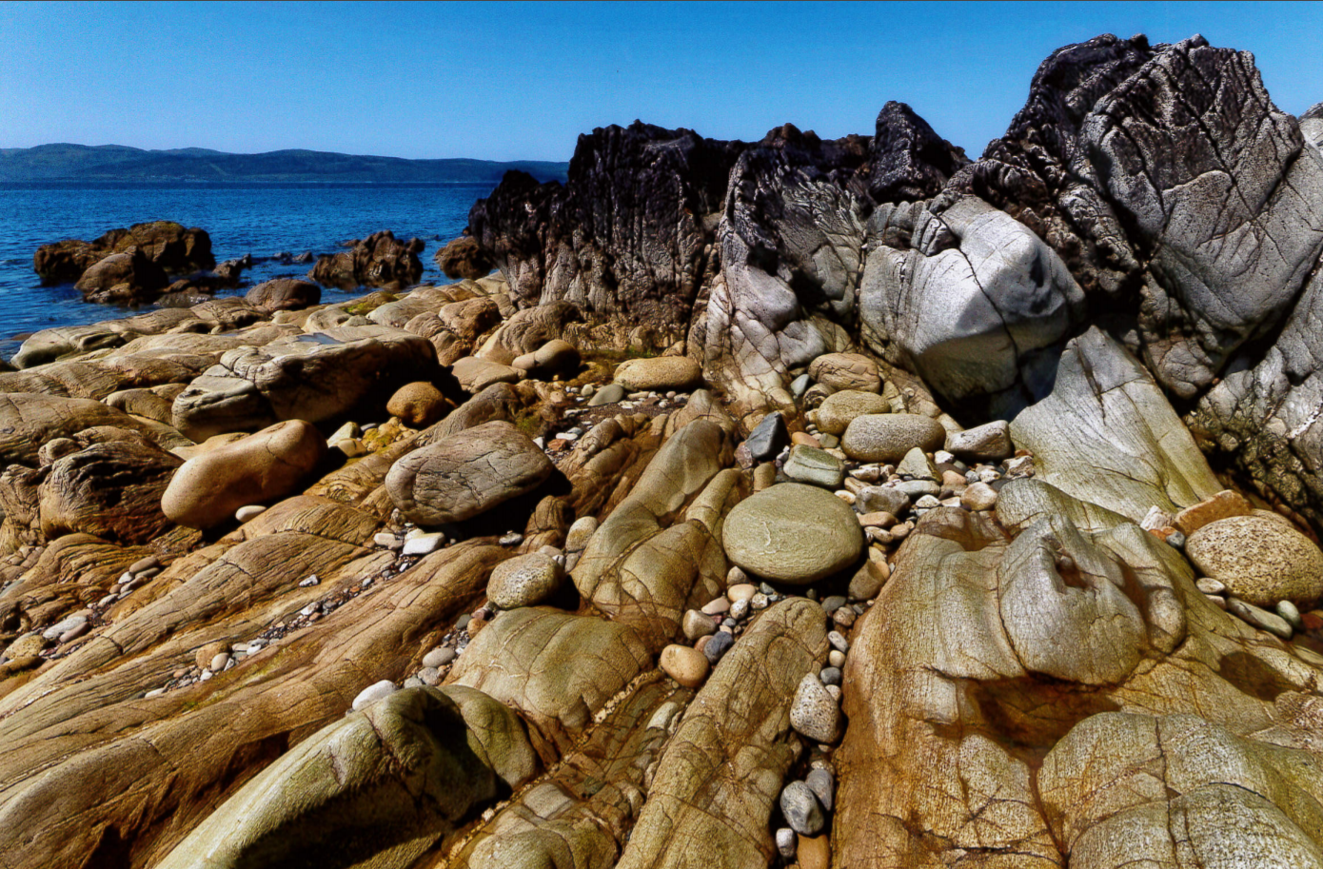
Arran’s Geology
Known as ‘Scotland in Miniature’, Arran sits astride the Highland Boundary Fault and showcases the country’s highland and lowland geology.
Described by the Geological Society of London as ‘one of the best geosites in the UK’, Arran’s rocks chart Scotland’s journey across the world...

Slide 8
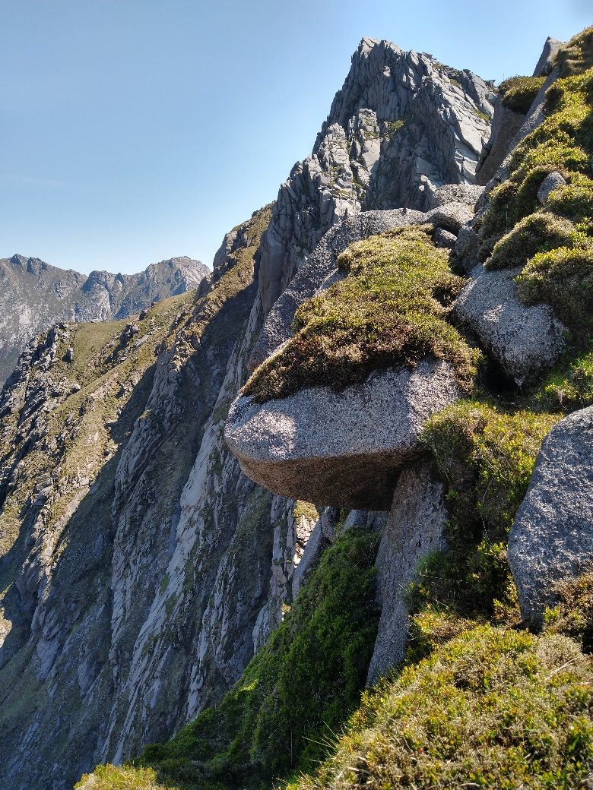
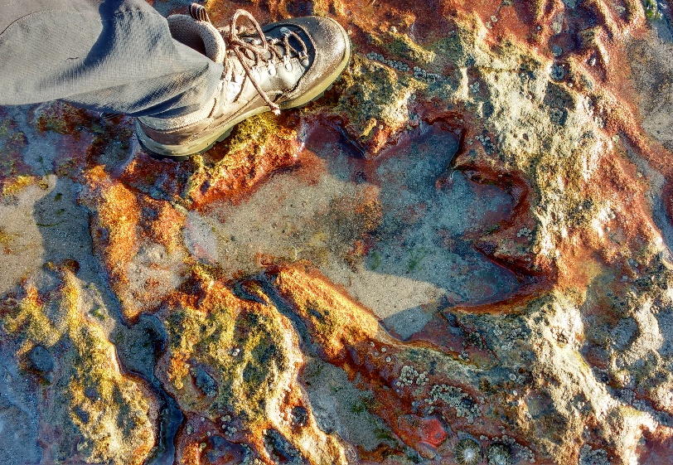
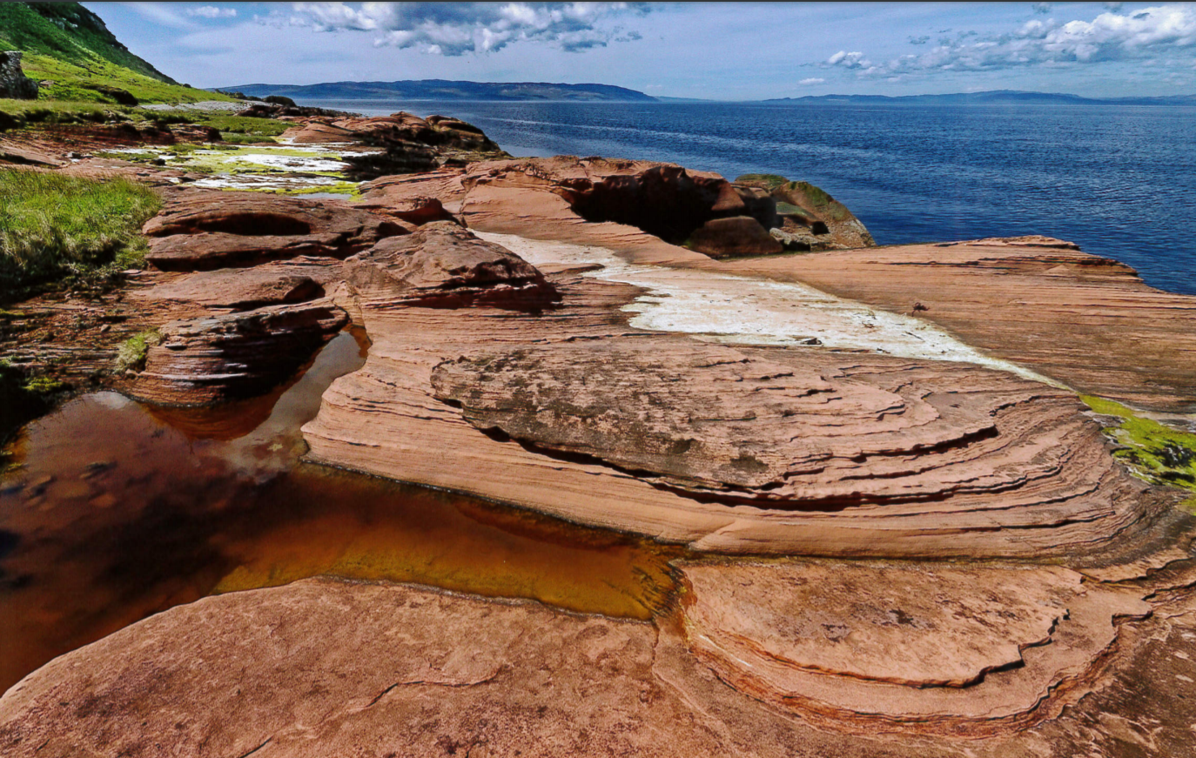
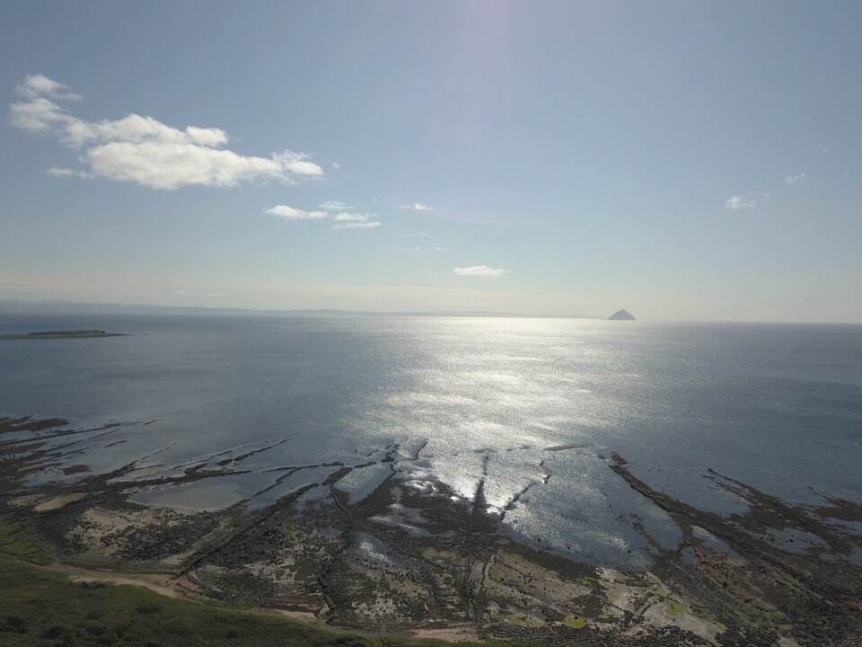
Arran’s Geology
towering granite mountains telling tales of a landscape shaped by fire and ice
the prints of Isochirotherium, or the hand-beast, a precursor to dinosaurs
sandstones remembering desert conditions
dykes and sills directing you to Arran’s magmatic past
Arthropleura, a giant myriapod trail filmed by David Attenborough, and amongst the oldest tracks of any land creature

Slide 9
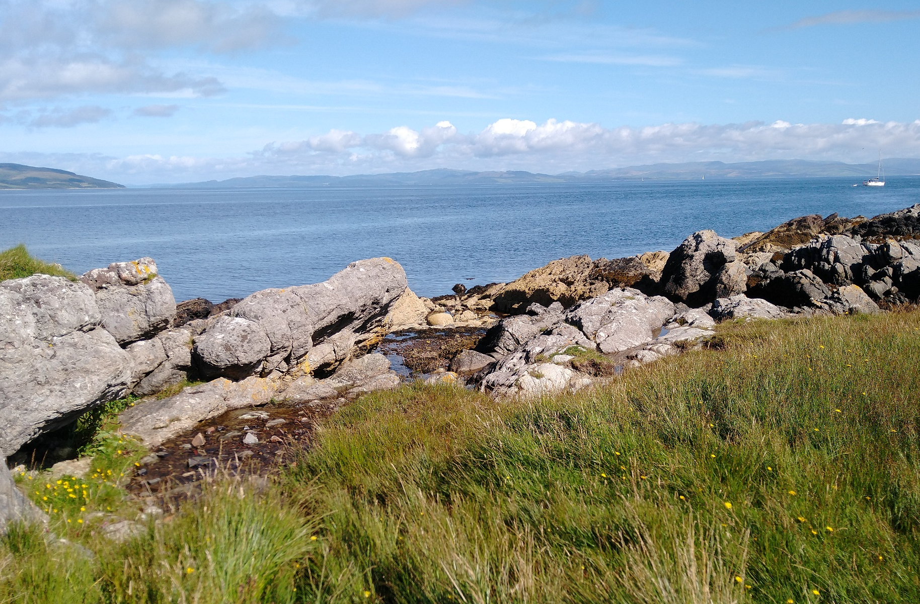
Hutton’s Unconformity
The outcrop off Lochranza’s coast where the ‘father of modern geology’ changed the way we view our planet forever

Slide 10
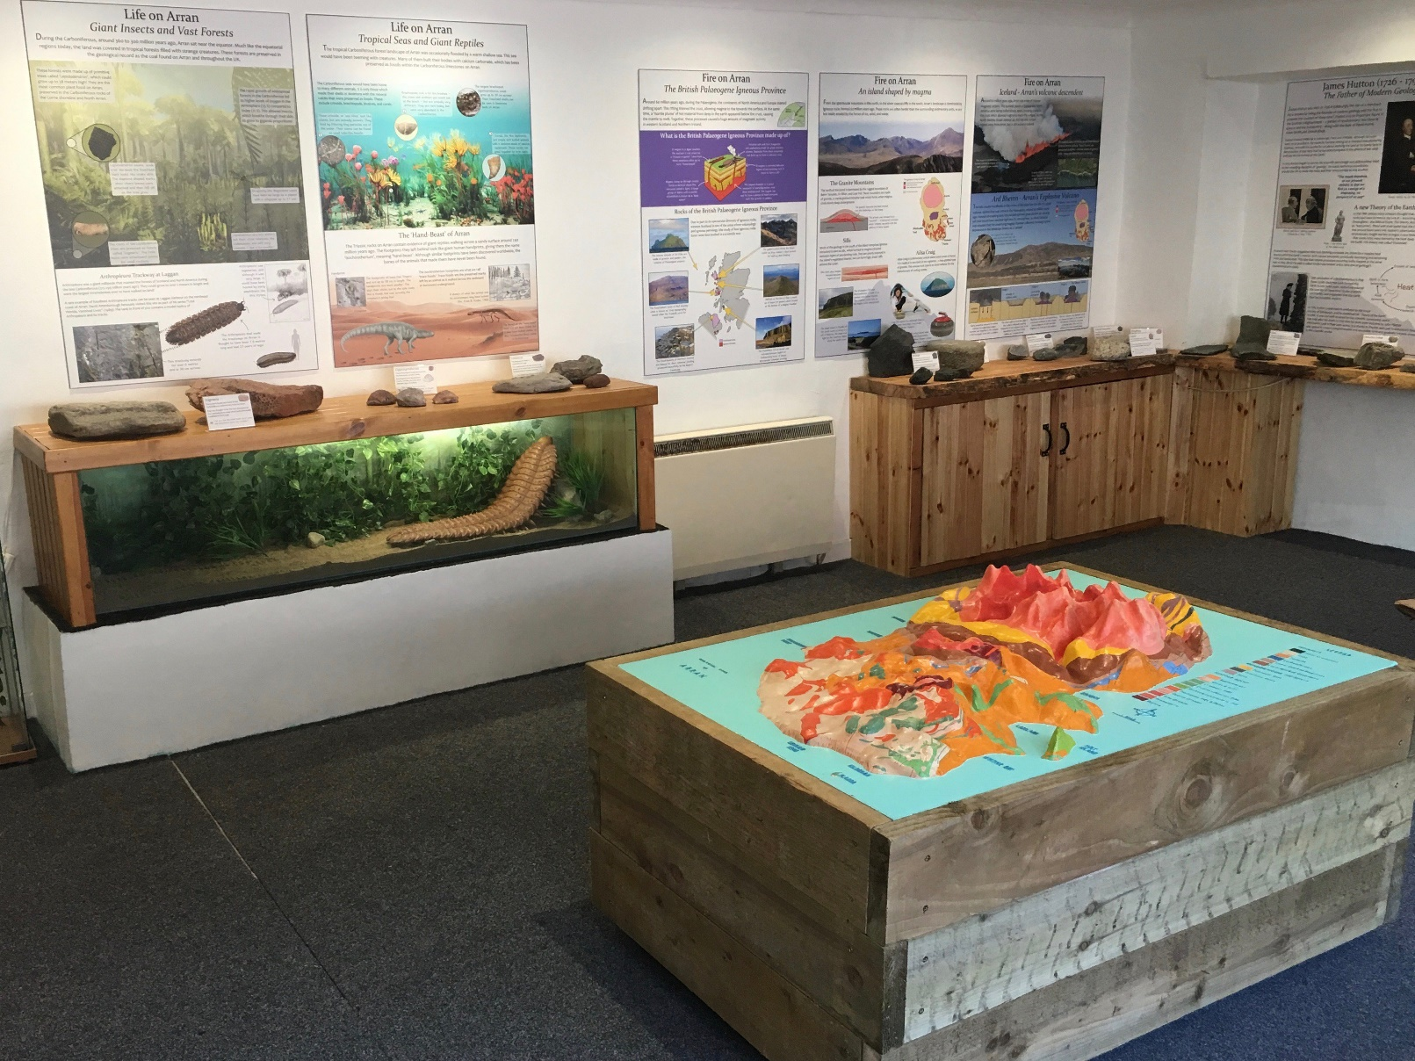
Geopark
The Arran Geopark aims to promote and conserve Arran’s spectacular and globally important geology.
Access to important geological sites has been improved, information on the geology of the island is available at interpretation centres, and self-guided walks have been established

Slide 11
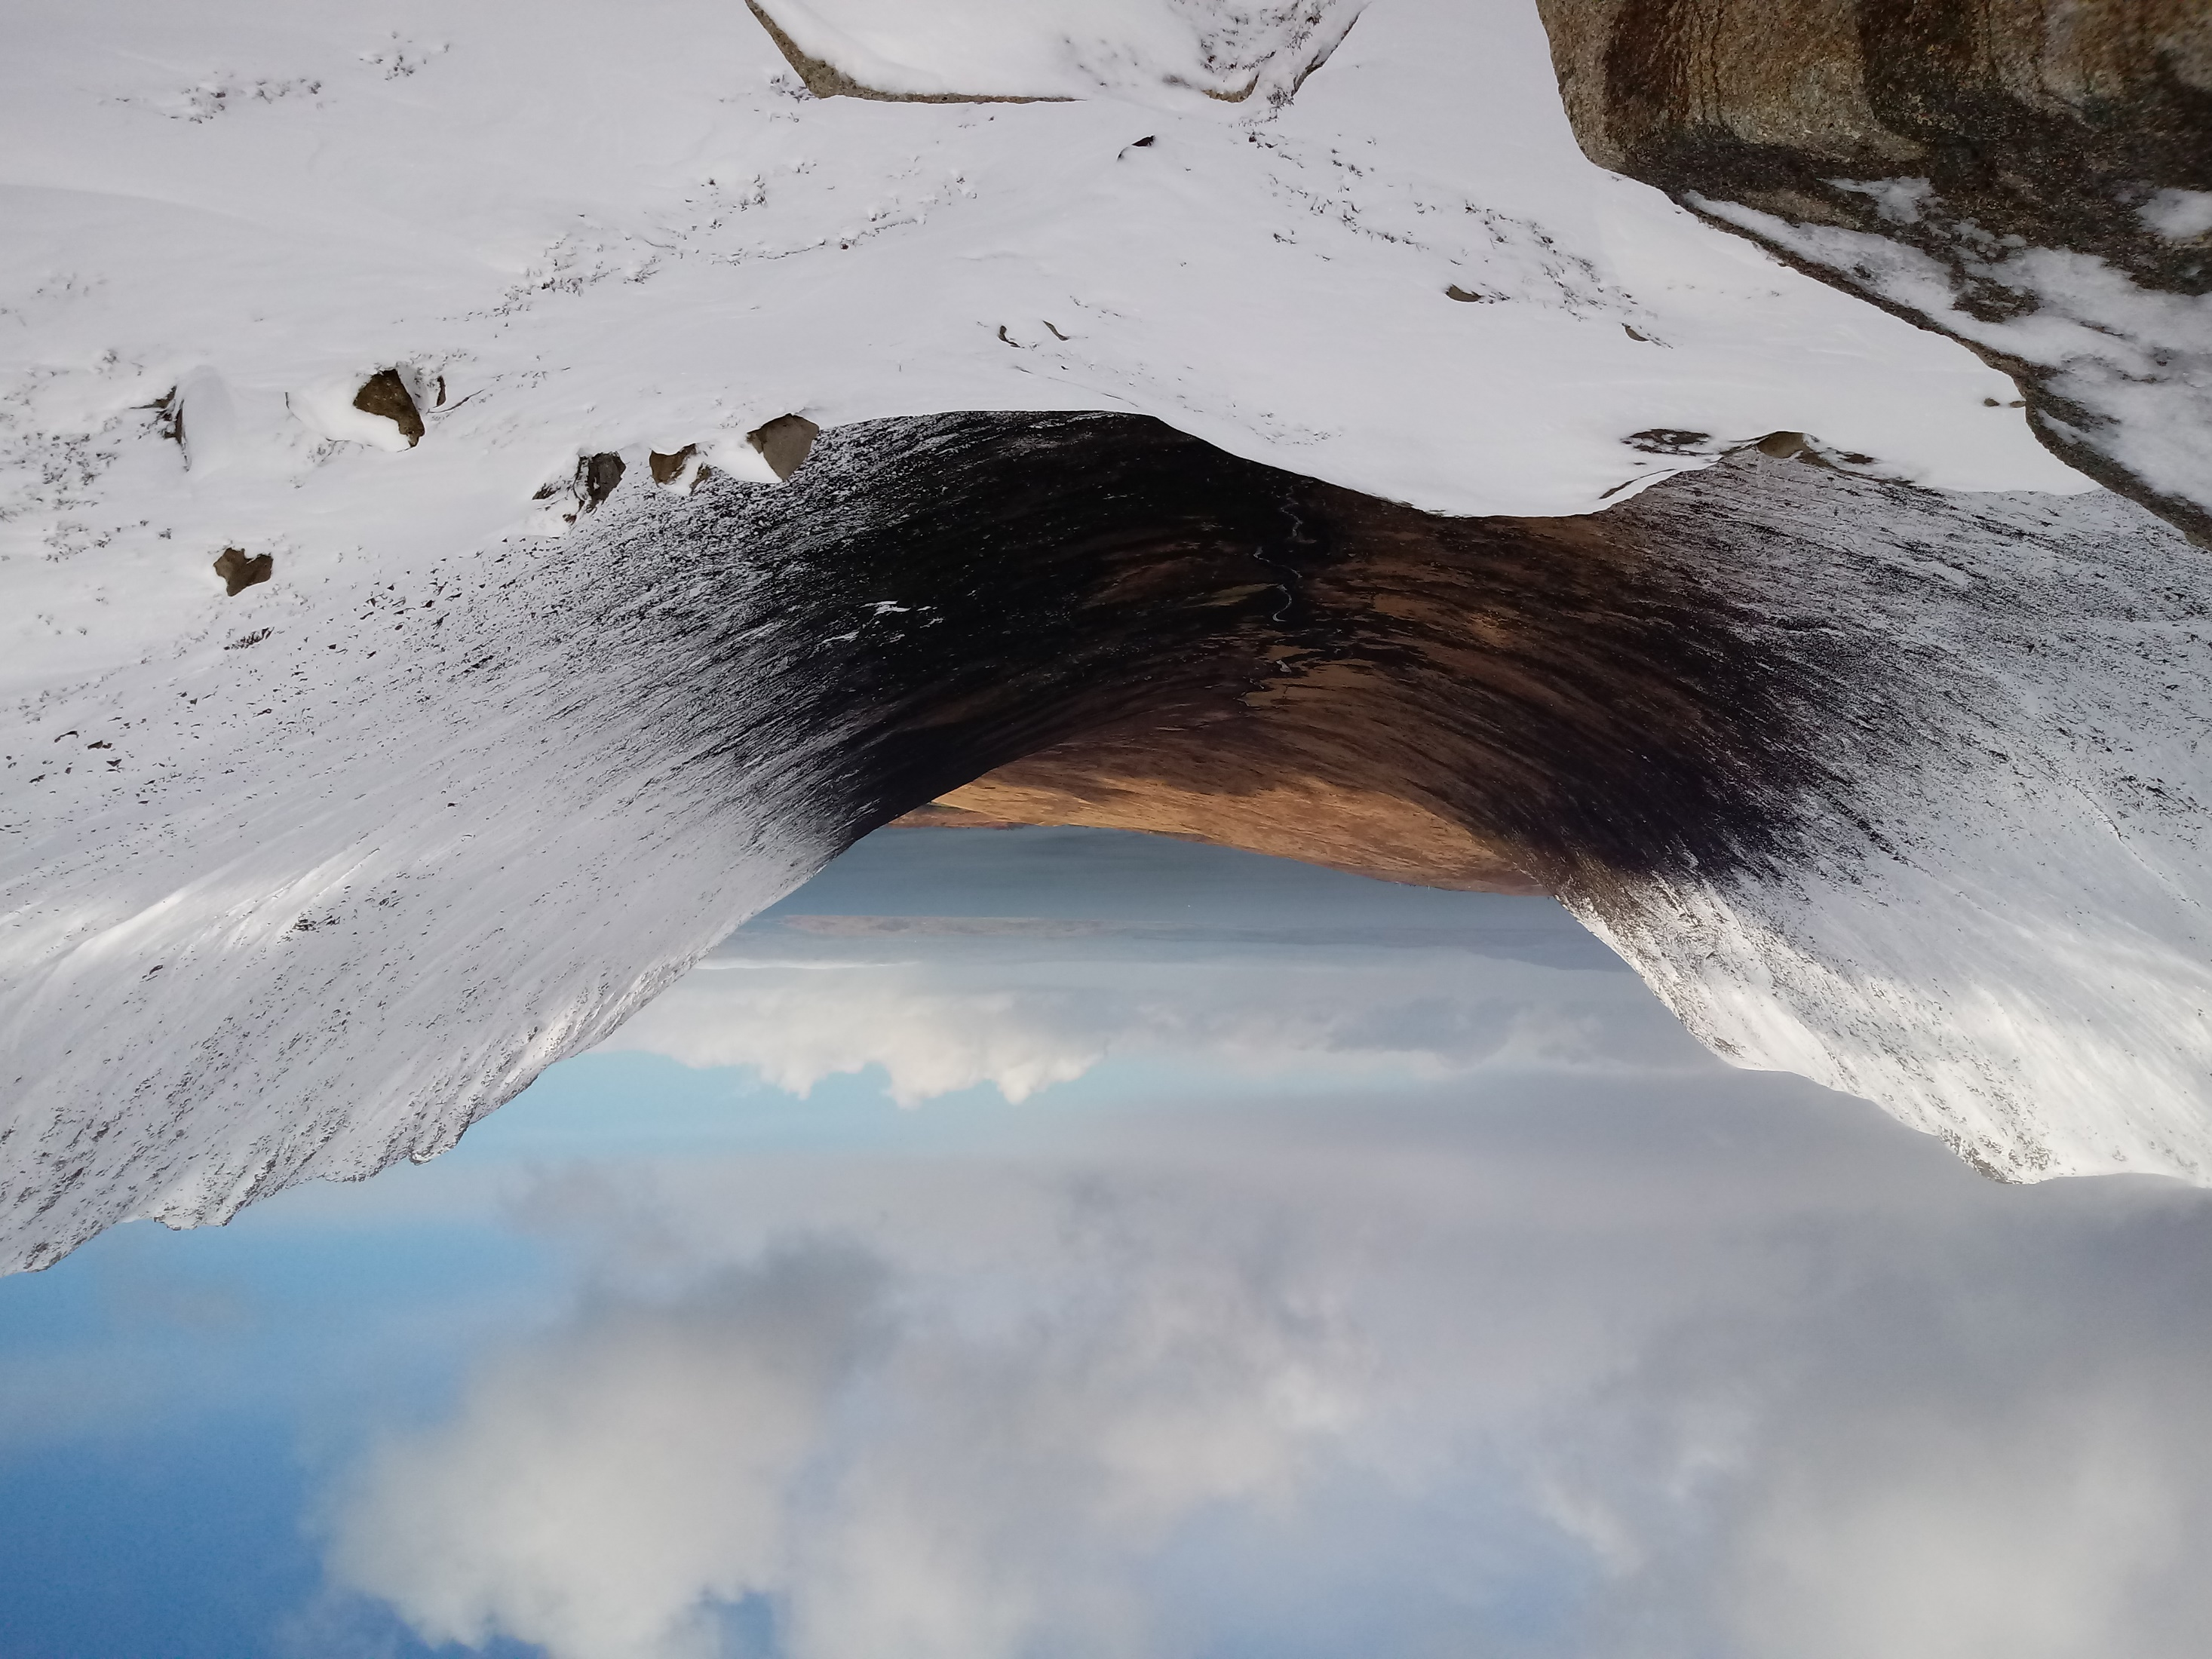
To find out more…
www.locharanzacentre.co.uk
www.youtube.com/channel/UC4WBRqCsRkCb50YuZPH0lCg
www.instagram.com/lochranzacentre
www.facebook.com/lochranzacentre
twitter.com/lochranzacentre
Come visit us! We look forward to you making the journey over the sea and truly experiencing the variety of Scotland’s geology…
www.festivalofgeology.org.uk
Lochranza Centre CIC Lochranza Isle of Arran KA27 8HL Scotland
 01770 830 637
 info@lochranzacentre.co.uk

