Slide 1
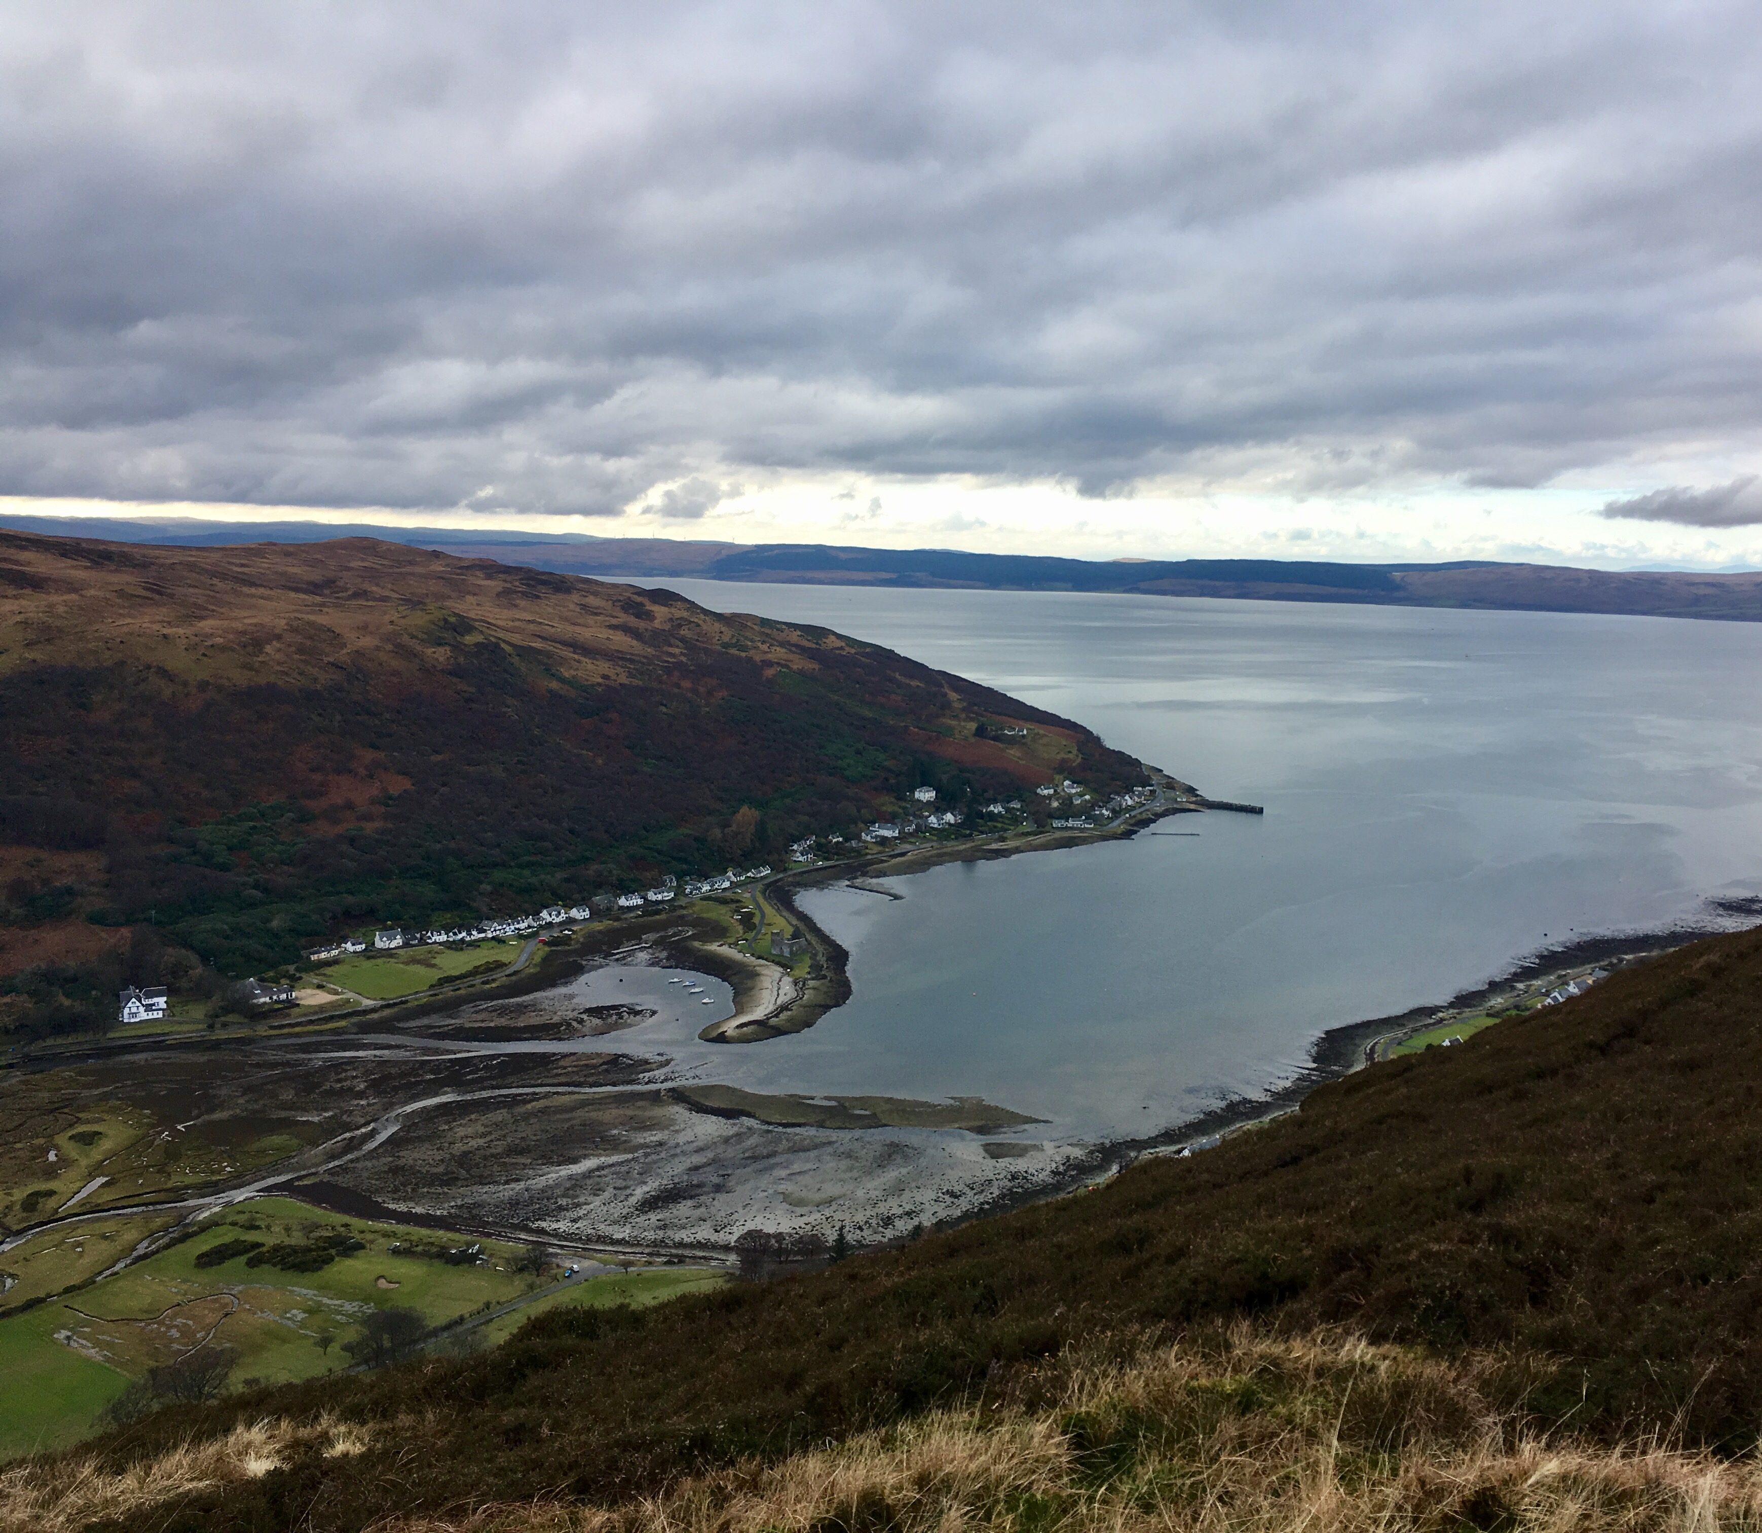
Coasts
Processes, features and management
Why study them?
Processes and Theoretical Background
Setting up an Investigation
Data Analysis and Interpretations
For useful information, see the ‘Notes’ section of the PowerPoint
Notes:
A view of Lochranza, featuring the salt marshes, castle spit and the village’s coastline.

Slide 2
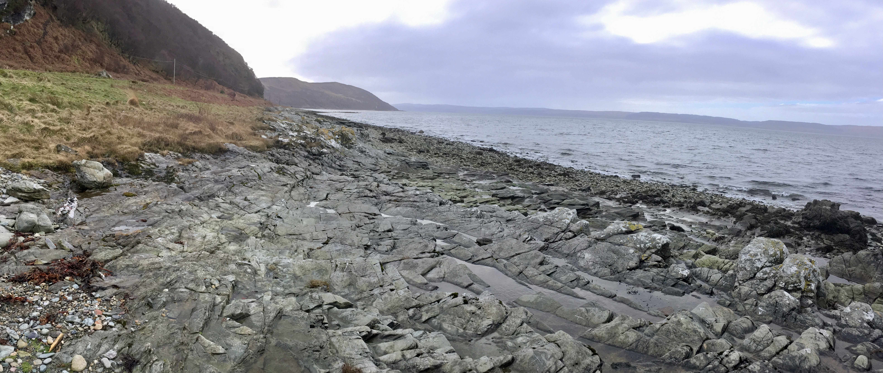
Why should we study coastal environments?
Notes:
See following slide for reasons.

Slide 3
Why should we study coastal environments?
Coasts are the interface between the land (terrestrial) and the sea (marine), providing a diverse range of habitats
650 million people (10% of world population) live within 10m of current sea level
Most active of all geomorphological environments: where marine, terrestrial, atmospheric and human processes and erosion interact
Sea level rise and issues regarding management means it is an area of contemporary geography
Most of Arran’s population lives close to current sea level and the main road around the island follows the coast closely
Notes:
Coast are a dynamic, ever-changing environment, being the interface between land and sea, so there are lots of interesting processes which occur along the coast. A whole variety of ecological niches exist on coastlines, supporting many very diverse populations of plants and animals within a relatively short area. Coasts and their processes need to be understood if these species are to be protected. Marine, terrestrial, atmospheric and anthropogenic factors all actively interact with each other in coastal environments, and if one of these factors is disrupted, it will influence all the others. A significant proportion of the world’s population lives at a low elevation and in close proximity to the current sea level, meaning they are very vulnerable to predicted sea level rise. Global sea level rise is a major contemporary issue – if current forecasts come to fruition, the effect on our natural environment and ecosystems, as well as on humans’ lives and livelihoods, will be devastating and quite transformative. So understanding coasts is essential if sea level rise is to be combatted, managed or adapted to. From a map of Arran, it is obvious that nearly all of the island’s settlements are coastal; the road hugs the coast, and the coastline is where houses and businesses exist. Flooding is already an issue in some of Arran’s villages, and sea level rise could have drastic consequences for the island.

Slide 4
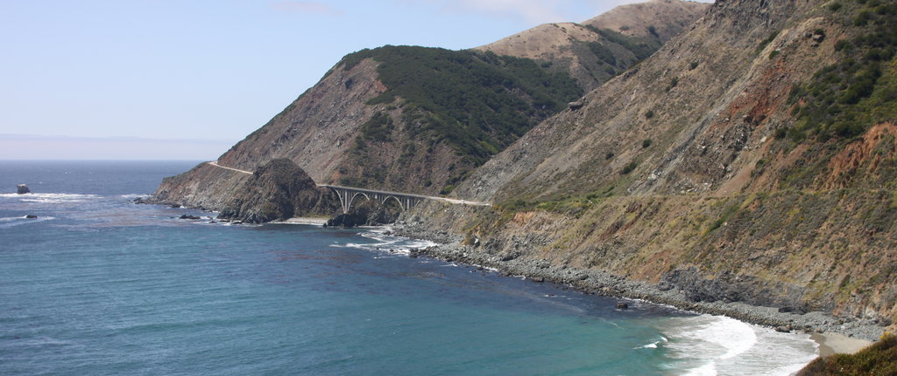
Processes and theoretical Background
Notes:
If anything is to be done about managing ever-changing coastal environments, and the spectacular lifeforms they support, and if sea level rise is to be adapted to, it is vital that we understand some of the processes and theoretical background of coasts.

Slide 5
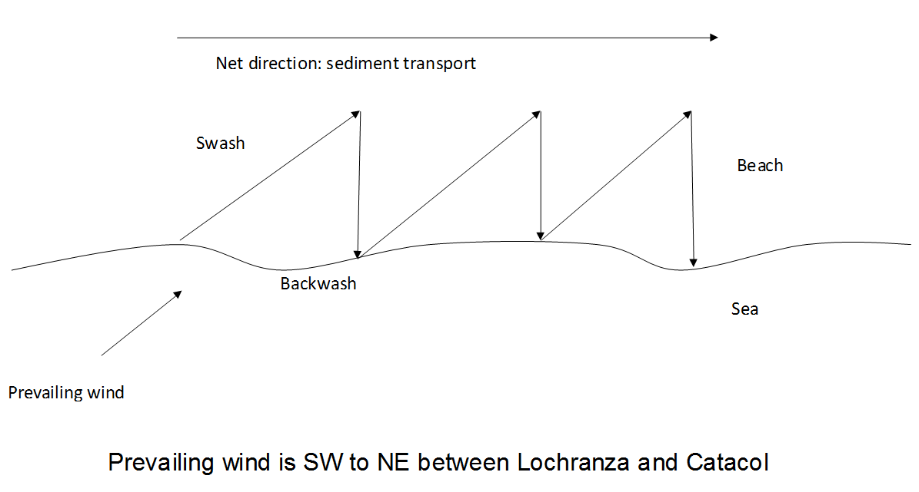
Which processes commonly occur along coasts?
Notes:
Longshore drift is a key process to understand at the coast. It is the movement of material along a coastline due to the angled approach of waves. In this diagram, the sea is in the bottom half of the slide, and the beach above. ‘Prevailing wind’ refers to the most common direction in which wind in a particular location travels; so, although the wind does not always blow from the southwest to the northeast between Lochranza and Catacol, it does most of the time. Swash is the water flowing towards the beach when a wave breaks, and backwash is the movement of water back down the beach. Swash follows in the direction of the prevailing wind, whereas backwash returns to the sea by the most direct route, meaning it always flows back down the beach perpendicular to the sea. Because the angle of swash is different to the angle of backwash, sediment caught up in the swash and backwash will be transported along the beach over time, in a zig-zagging fashion. The diagram above shows the net direction of sediment transport.

Slide 6
Overview of North Arran’s Geology
Lochranza Bay – low energy environment
Lochranza
Catacol Bay
R Chalmadale
R Catacol
Prevailing Wind
Granite
Phylite
Kilbrannan sound – high energy environment
Notes:
At the Lochranza Centre, we study longshore drift between Catacol and Lochranza, and we study it by looking at the pebbles along the coast. However, we need to be selective in the rock type of the pebbles we study. Therefore, it’s important to know a little bit about the island’s geology. In the centre of the north end of the island, the red circle represents a huge granite blob, which is where all Arran’s dramatic mountains are. Around this blob, the green represents phyllite, which is a metamorphic rock. Our study runs from Catacol to Lochranza, and from the map you should be able to see that along this section of coast, the underlying rock is all phyllite. Consequently, any phyllite one finds on the shore in Lochranza need not have reached this point due to longshore drift; it could just have been eroded from the underlying bedrock. However, with granite, the only place along this stretch of coastline that it could have originated from is Catacol, because this is where the mouth of the River Catacol, with its source in the granite mountains, is located. So any granite must have come first from the central mountains, then been transported down the River Catacol, entering the sea at Catacol Bay, and then been transported around the coast by longshore drift. So studying granite rather than phyllite removes a layer of uncertainty from our study, as one can be confident that its presence anywhere near Lochranza will be a direct consequence of longshore drift.
Why Granite? Granite originates in the mountains in the north of the island and the River Catacol transports and deposits it onto the coast. Longshore drift transports granite from Catacol towards Lochranza dictated by south-westerly prevailing winds. The underlying bedrock between Lochranza and Catacol is phyllite. Phyllite may not be involved in longshore drift. It could quite conceivably have been eroded from underlying material, hence adding a degree of uncertainty.
Longshore Drift: The transportation of sediments along coast at an angle to the shoreline which is dependent on prevailing wind. It is a zig-zag movement of sediment by swash and backwash.
6

Slide 7
Setting up an investigation

Slide 8
Geographical Enquiry
Theory
Aim
Sampling Strategy
Location
Hypothesis
Gathering Techniques
Data Collection
Risk Assessment
Data Presentation
Analysis
Results & conclusions
Notes:
This is a flowchart showing the process which should be followed when conducting fieldwork.
First, establish an aim – what you intend to achieve with your study. This will be informed by relevant theory about, in this case, coastal processes, so you have an idea of what you might expect to find. The specific location in which you conduct your fieldwork will affect what can be studied and what outcomes might be expected, so must be decided on at an early stage. A hypothesis can then be written – this is a testable predicative statement about your study’s outcome, which your study should be able to either prove or disprove.
Next, data can start to be collected, as long as a sampling strategy has been decided and gathering techniques considered. Before any fieldwork can be conducted, a site-specific risk assessment is required, to plan for, limit and manage potential hazards.
Once data has been collected, it can be presented clearly, through text, images, graphs, maps and diagrams, to aid its interpretation by you and any others reading your study. It can then also be analysed, by seeking out trends and anomalies. Statistical tests may be useful. Results can then be written up, and conclusions drawn. The entire process should then be evaluated. Ideally, this can be treated as a pilot study, and can then be repeated ‘for real’, with improvements.
8

Slide 9
Hypothesis
Hypothesis
With distance from the mouth of River Catacol, granite clasts will become smaller and more rounded due to the process of long shore drift.
Null Hypothesis
With distance from the mouth of River Catacol, there will be no change in granite clast size and roundness.
Cause and effect - is the change in granite clasts strictly due to LSD?
Notes:
Copy
Null hypothesis – what we’re seeking to disprove.

Slide 10
Questions
What pebble measurements do we need to take?
What composition should the pebbles be?
Which types of sampling methods would be most appropriate?
Would statistical analysis be applicable?
Notes:
Under the influence of longshore drift, pebbles would be expected to become smaller and more rounded – as we work our way along the coast, pebbles nearer Lochranza should have spent more time in the sea being transported and thus been eroded down to become smaller and rounded. To study this, the length of pebbles’ B-axis should be measured, and their shape or roundness should also be noted. As explained, the pebbles studied should be granite (rather than phyllite). Our study of longshore drift between Catacol and Lochranza takes the form of an interrupted belt transect, as this allows us to measure changes in the pebbles on the shore in a regular, thorough and representative way, without taking as much time as would be required for a continuous belt transect. When selecting pebbles at each point along the interrupted belt transect, systematic sampling is followed, to reduce bias. Various statistical tests would be appropriate for the collected data; for instance, Spearman’s Correlation Coefficient could be found to see if there is a statistically significant relationship between changing rock size of pebbles and distance from Catacol.

Slide 11
Strategy
1. Using an appropriate scale, measure the roundness and size of granite clasts along a 500m transect between Catacol and Lochranza
2. Conduct systematic sampling to ensure a fair study
3. Look at how the clast size changes going away from the sea on a separate 15m transect to observe if there are any trends caused by factors outside of longshore drift
4. Use appropriate methods to display, analyse and interpret the data in order to either accept of reject the hypothesis
Notes:
11

Slide 12
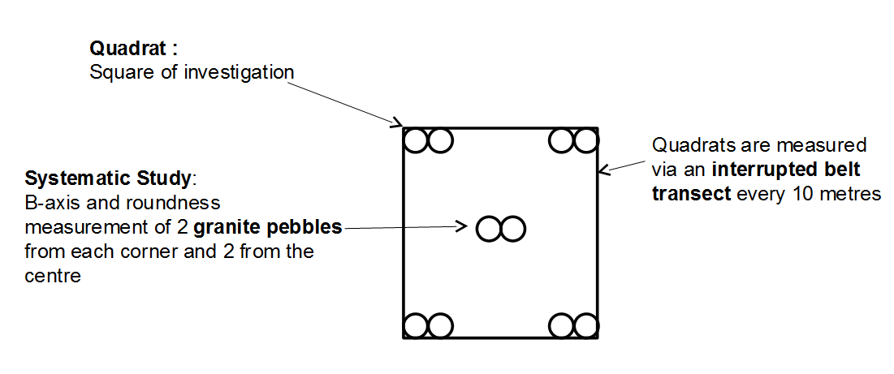
Longshore Drift Method
Quadrats are measured via an interrupted belt transect every 50 metres
Notes:
This is the interrupted belt transect, between Catacol and Lochranza. Every 50 metres along the shore, a quadrat is positioned (generally just below the strand line, so as to keep at an even distance up the beach throughout). From within this quadrat, ten granite pebbles are selected – two from each corner and two from the centre. This ensures systematic sampling – one is not just picking to measure the pebbles that look as though they will fit the expected data trend. Each pebble’s B-axis and roundness should be measured, using callipers and Power’s Roundness Index respectively.

Slide 13
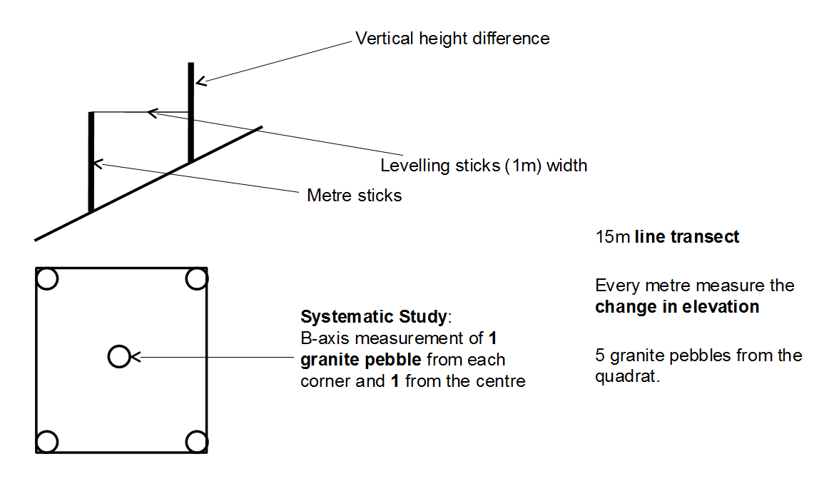
Beach Profile Method
Notes:
In addition to the transect between Catacol and Lochranza, a beach profile can be measured on up to three occasions along this coastline. This is a continuous belt transect – rather than laying the quadrat every 50m, as in the previous method, here the quadrate are placed to form a continuous line between the sea and the top of the beach. So, rather than running parallel to the sea, as for the last transect, this transect runs perpendicular to the sea. Two things are done here – firstly, a quadrat is placed, and five granite pebbles are selected (one from each corner, and one from the centre), and their B-axis is measured. Secondly, two metre ruler sticks are held upright, a metre apart, one at either end of the quadrat. A 1m spirit level is then held between them, level with the top of the lower metre stick on one side, and touching the other metre stick at a right angle. By noting the number of centimetres between the top of this metre ruler stick and the point at which it is met by the spirit level, one knows the difference in elevation over this 1m section of the beach. Repeat both these stages – the pebble measurements, and the levelling – all the way up the beach, from the sea to the top of the beach.
A beach profile is worth knowing about because the angle of a beach affects the relative strengths of the swash and backwash, and therefore also affects longshore drift. By looking at the pebbles over the course of the beach profile, one can see whether granite pebbles’ sizes are different up and down the beach; if they remained uniform, this would indicate that longshore drift is the only factor influencing their distribution, but if they vary, this suggests additional processes are at play.

Slide 14
Risk Assessment
Hazard | Risk | Likelyhood | Severity | Mitigation
Something that might cause harm | What dangerous event could take place | How likely it is to happen on a scale of 1-5 (1 being very unlikely, 5 being very likely) | How bad it could be on a 1-5 scale | How to limit the risk
e.g. Water | Drowning | 1 | 5 | Wear lifejacket, never go above welly-depth in the river, and throw-line to be carried
Notes:
All our studies at the centre require a detailed risk assessment. What factors do you think would have safety implications for our river study? One example is given here, but plenty of others exist – for instance, the weather, access to sites, walking on roads…
.
14

Slide 15
What to do with your data and what it all means
Data analysis and interpretations

Slide 16
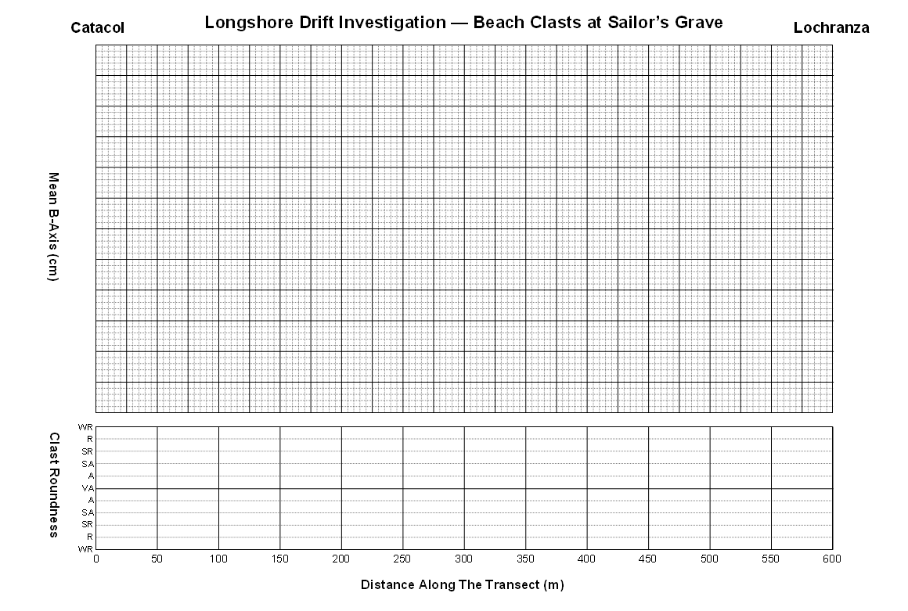
Longshore Drift Analysis
Distance (m) | Mean B-Axis (cm) | Mode Shape | Standard Deviation
Notes:
Longshore Drift Analysis
The same x-axis scale applies for both graphs here. Plot the distance along transect against mean B-axis as a scatter graph, and if possible add a line of best fit. Check these results using Spearman’s. Various factors could influence the result, including the presence of the sea wall, the headland, and the shortness of the distance covered by the transect. Clast roundness can be plotted beneath, as a kite diagram, shading the area within the ‘kite’. The kite diagram would be expected to show increasing roundness with distance along the transect, and the scatter graph would be expected to show decreasing size with distance. These graphs allow two sets of data to be presented visually for easy comparison.
16

Slide 17
BEACH PROFILE
Mean B-axis (cm)
Cumulative height (cm)
Distance up beach (m)
Notes:
Beach Profile
Create two separate scales for the y-axis, one for the mean B-axis and one for the accumulative height. Plot the beach profile as a line, using the accumulative height data. Add a scatter graph for pebble mean B-axis. A line of best fit through the B-axis data should run in the opposite direction to the direction of the beach profile, as the larger pebbles stay at the bottom of the beach (because they are too heavy to get moved upwards, and if they get to the top of the beach, they have enough weight to roll back down).
17

Slide 18
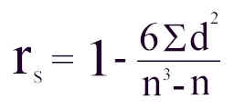
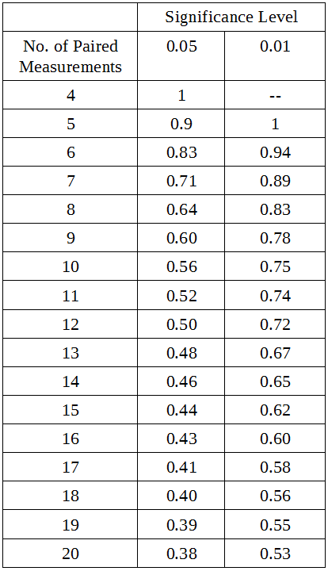
Spearman’s Rank Correlation
Finds if a correlation shown on a graph is statistically significant
Stage 2
Stage 1
n = number of paired measurements (n =12)
1. Set a null hypothesis
2. Input your data to the table
3. Rank data sets separately, from lowest to highest
4. Fill out the rest of the table columns and total
Stage 3
Distance from start (m) | R1 | Mean b-axis (cm) | R2 | d (R1-R2) | d²
0
50
100
150
200
250
300
350
400
450
500
550
600
Σd² (Total)
r_{s} must be higher than the critical value for there to be a statistically significant relationship
eg. 12 paired measurements, r_{s} must be higher than 0.50

Slide 19
Mann Whitney U Test
Tests the relationship between two sets of data – is there a statistical trend?
A minimum of five pieces of data are required in each set. Sets can be of different sizes.
Test against the Null Hypothesis.
Null Hypothesis
With distance from the mouth of River Catacol, there will be no change in granite clast size and roundness.
Notes:
Mann Whitney
This statistical test removes the possibility of results being skewed by anomalous data collected around the headland between Catacol and Lochranza, where longshore drift patterns may be disrupted.
19

Slide 20
Mann Whitney U Test
Stage 1
1.Enter your data on the table.
2. Rank all the data as a whole.
3. Add up all the ranks for sample X (∑r_{X} ) and sample Y (∑r_{Y} ).
Stage 2
(
)
(
)
n_{X} (n_{X} + 1)
2
n_{Y} (n_{Y} + 1)
2
U = n_{X} x n_{Y} +
- ∑r_{X}
U = n_{X} x n_{Y} +
- ∑r_{Y}
Sample X: Catacol pebbles |  | Sample Y: Lochranza pebbles
Pebble Size (cm) | Rank | Pebble Size (cm) | Rank
∑r_{X} = |  | ∑r_{Y} =
Sample X: Catacol pebbles |  | Sample Y: Lochranza pebbles
Pebble Size (cm) | Rank | Pebble Size (cm) | Rank
∑r_{X} = |  | ∑r_{Y} =
nx and ny= number of values in sample ‘X’ and sample ‘Y’
∑rX and ∑rX= respective sum of the rank values
Sample X: Catacol pebbles |  | Sample Y: Lochranza pebbles
Pebble Size (cm) | Rank | Pebble Size (cm) | Rank
∑r_{X} = |  | ∑r_{Y} =
Stage 3
1. Find the number of ranked pairs (eg. 10 rankings= 5 pairs)
2. Use the smallest ‘U’ value
3. If the U value is less than the critical value (2) then we
can accept our alternative hypothesis and reject Null Hypothesis.
 | 2 | 3 | 4 | 5 | 6 | 8 | 7 | 8 | 9 | 10
2 | 0 | 0 | 0 | 0 | 0 | 0 | 0 | 0 | 0 | 0
3 | 0 | 0 | 0 | 0 | 1 | 1 | 1 | 2 | 2 | 3
4 | 0 | 0 | 0 | 1 | 2 | 3 | 3 | 4 | 4 | 5
5 | 0 | 0 | 1 | 2 | 3 | 5 | 5 | 6 | 7 | 8
6 | 0 | 1 | 2 | 3 | 5 | 6 | 6 | 8 | 10 | 11
7 | 0 | 1 | 3 | 5 | 6 | 8 | 8 | 10 | 12 | 14
8 | 0 | 2 | 4 | 6 | 8 | 10 | 10 | 13 | 15 | 17
9 | 0 | 2 | 4 | 7 | 10 | 12 | 12 | 15 | 17 | 20
10 | 0 | 3 | 5 | 8 | 11 | 14 | 14 | 17 | 20 | 23

Slide 21
Drawing the Coast Profile Transect
Catacol
Lochranza
Scale 1cm = 50m
Notes:
Compass Constructed Coastline
Use a scale of 1cm = 50m. Place the centre of a protractor over the dot marked for Catacol, with 0° of the protractor above the dot (90° will be to the right of the dot, and 180° beneath the dot). In pencil, mark the bearing you got for the first site from Catacol. Remove the compass, and join this mark with the original dot using a ruler, and draw a centimetre-long line. At the end of this line, make another dot, and from this dot repeat the process using the protractor and ruler, and continue to do so until you have a line stretching across the page from Catacol to Lochranza which resembles the shape of the coastline between the two villages. This is useful for identifying any changes in the coastline which could influence longshore drift.
21

Slide 22
Benefit of a Pilot Study
Notes:
This diagram shows that with an increasing sample size, the mean B-axis levels off, as anomalies are better absorbed within the data when there is a greater sample size. The results are more reliable when there is less deviation within them.

