Slide 1
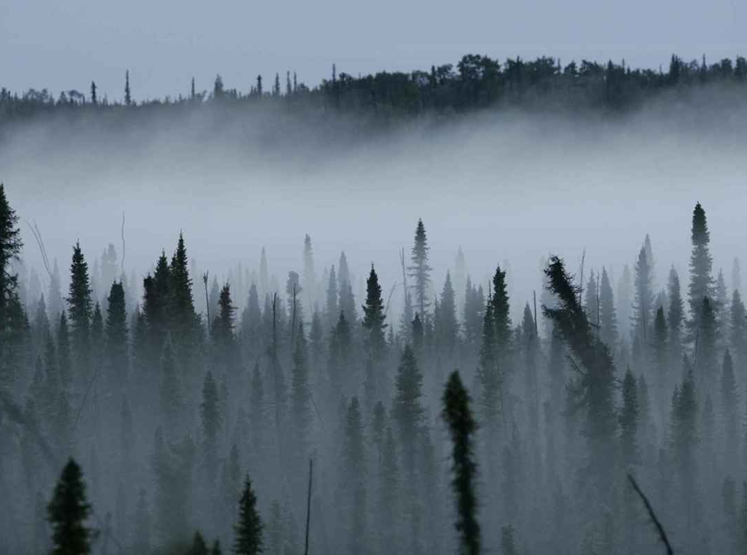
Ecosystems and the carbon cycle
Investigating the movement of carbon through ecosystems
Theory on the Carbon Cycle
Stages of an investigation
Linking Carbon and Ecosystems
Data collection, presentation & analysis
For useful information, see the ‘Notes’ section of the PowerPoint

Slide 2
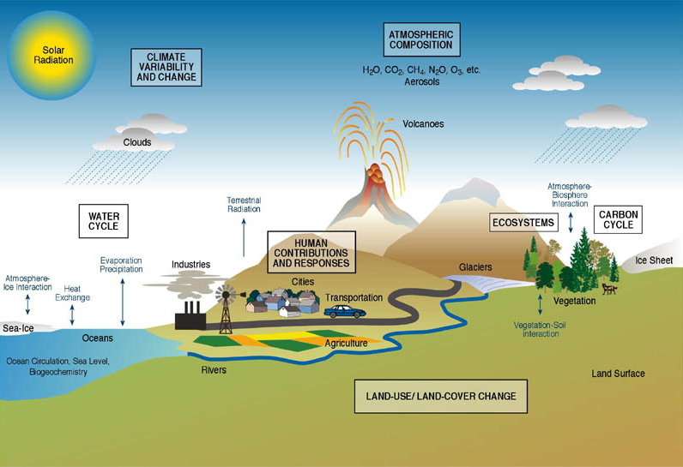
Global Earth Systems
https://www.agci.org/education/fundamentals
Notes:
Geography can be considered as a study of systems, all of which interact with eachother. Can you name some of the Earth’s systems, based on this slide? See the next slide for a list of examples.

Slide 3
Notes:
3
These are different systems which can be studied in Geography. Our study of the carbon cycle will focus particularly on the biosphere, but carbon is also present and important in all of the other systems. The anthroposphere refers to the human world, from our built infrastructure and industries to our land uses to our digital connections – all of these interact with the ‘natural’ world, to an extent where it seems impossible to disentangle nature from the anthroposphere. Humans as a species are responsible for the unprecedented rate of carbon release into the atmosphere which has occurred since the industrial revolution.
The Earth’s atmosphere – the gases which surround Earth – represent another system, which regulates our Earth’s environment. Carbon dioxide accounts for 0.04% of Earth’s atmosphere.
The Biosphere is the Earth system which contains all life, be it plant or animal. Plants photosynthesise by converting carbon, which they extract from other systems, into energy, and this energy is then stored within them and transferred to animals when the animals consume plants. When plants die, carbon is returned to the atmosphere and ocean as carbon compounds, before being recycled again by growing plants.
The cryosphere is the frozen portion of Earth. Tundra – the biome which belongs to cold environments near the north pole – holds a lot of carbon within permafrost (permanently frozen ground). There is currently around twice as much carbon stored in permafrost as exists in the atmosphere.
The hydrosphere is the Earth system which relates to water. Earth’s surface is 70% water, and stores carbon as dissolved CO₂, and as calcium carbonate in corals and shells. There are also methane stores within the ocean floor which currently hold large amounts of carbon. The hydrosphere is the second largest store of carbon.
By far the Earth’s largest carbon store is the geosphere, or lithosphere, which holds the carbon locked away in rocks. This includes hydrocarbons, like fossil fuels, as well as sediments and sedimentary rocks which contain large amounts of calcite.

Slide 4
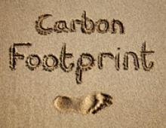
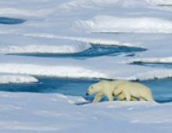
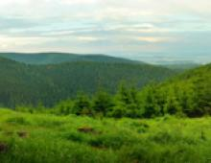
Five principles of global environmental change
Earth's natural systems undergo continual change.
Earth's systems are linked through interactive processes.
Recently, humans have become a key agent of change.
Local changes have global consequences.
Global environmental change impacts all life.

Slide 5
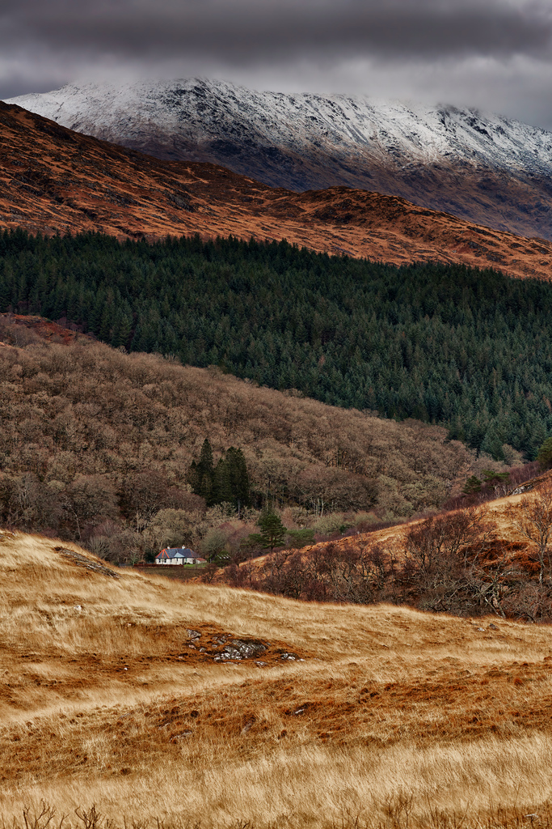
Ecosystems
A unit which links
living organisms
(plants, animals, people)
with their
physical environment
(rock, soil, air and water)
Notes:
How many ecosystems can you identify in this picture? We distinguished seven: in the foreground, there is the ecosystem comprising the grass and the soil, and any organisms which interact with these; next, there is a house visible, with a plot of land, indicating there are humans here, with their own associated ecosystem; then, there is a deciduous forest and its underlying physical environment, which support particular species and processes; and then a coniferous forest with its own associated living organisms and bedrock and soil; then, a heather moorland overlying peat, which is a distinct ecosystem; then, the snowy hilltops, which will still support their own forms of algae- and bacteria-based life; and finally, the clouds, a physical environment of air and water which also hold life in the form of bacteria.
You may have identified more or fewer ecosystems than this; it depends very much on the scale at which one looks. An ecosystem does not have a geographically set size, but is instead a useful concept when trying to break down the environment into different compartments – or systems – to be studied (and compared).

Slide 6
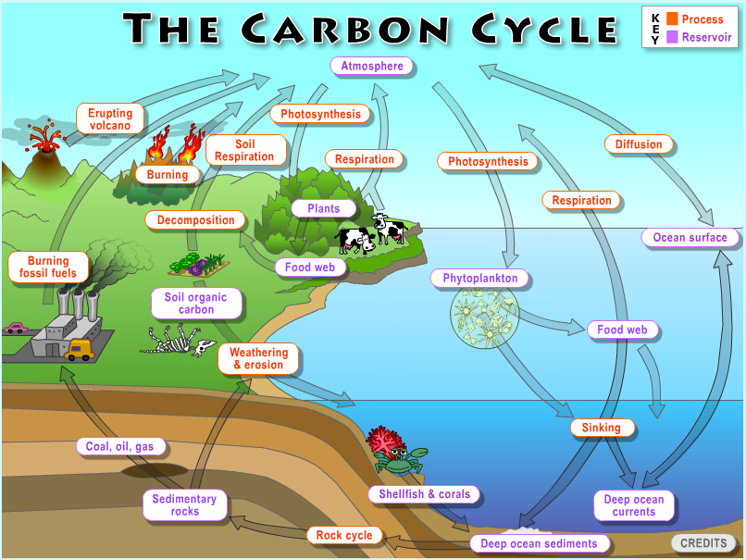
Processes
Fluxes
Stores
http://serc.carleton.edu/eslabs/carbon/index.html
The path through which carbon is exchanged between the Earth's spheres: Hydrosphere, Cryosphere, Lithosphere, Biosphere, Atmosphere
Notes:
6
The carbon cycle looks at how carbon is exchanged around the Earth between the different spheres. This diagram shows there are lots of different processes, organisms and factors involved. All the purple text represents carbon stores, in different forms, from organic held in rocks or gaseous CO₂ held in the atmosphere. Red text refers to the process involved in moving carbon from one store to another, such as photosynthesis and respiration. A flux is the movement of carbon from one store to another, and its direction is represented by the arrows.
The movement on carbon happens on different time scales:
FAST – plants are photosynthesising and respiring every second. Photosynthesis uses atmospheric CO₂ and sunlight to create organic material and grow, whilst continuing to respire at all times and thus releasing CO₂ back into the atmosphere.
MEDIUM – operates on a months-to-centuries timescale, and includes the transfer of organic carbon from plants to soils as the plants die and break down, and the non-organic ocean/atmosphere exchange of CO₂.
SLOW – hundreds of millions of years: a geological timescale, involving the longterm removal of carbon into rocks as fossils in coal etc. It is naturally released back via volcanic eruptions. NOTE: burning of fossil fuels is speeding up this process considerably! Disrupting the natural carbon cycle?

Slide 7
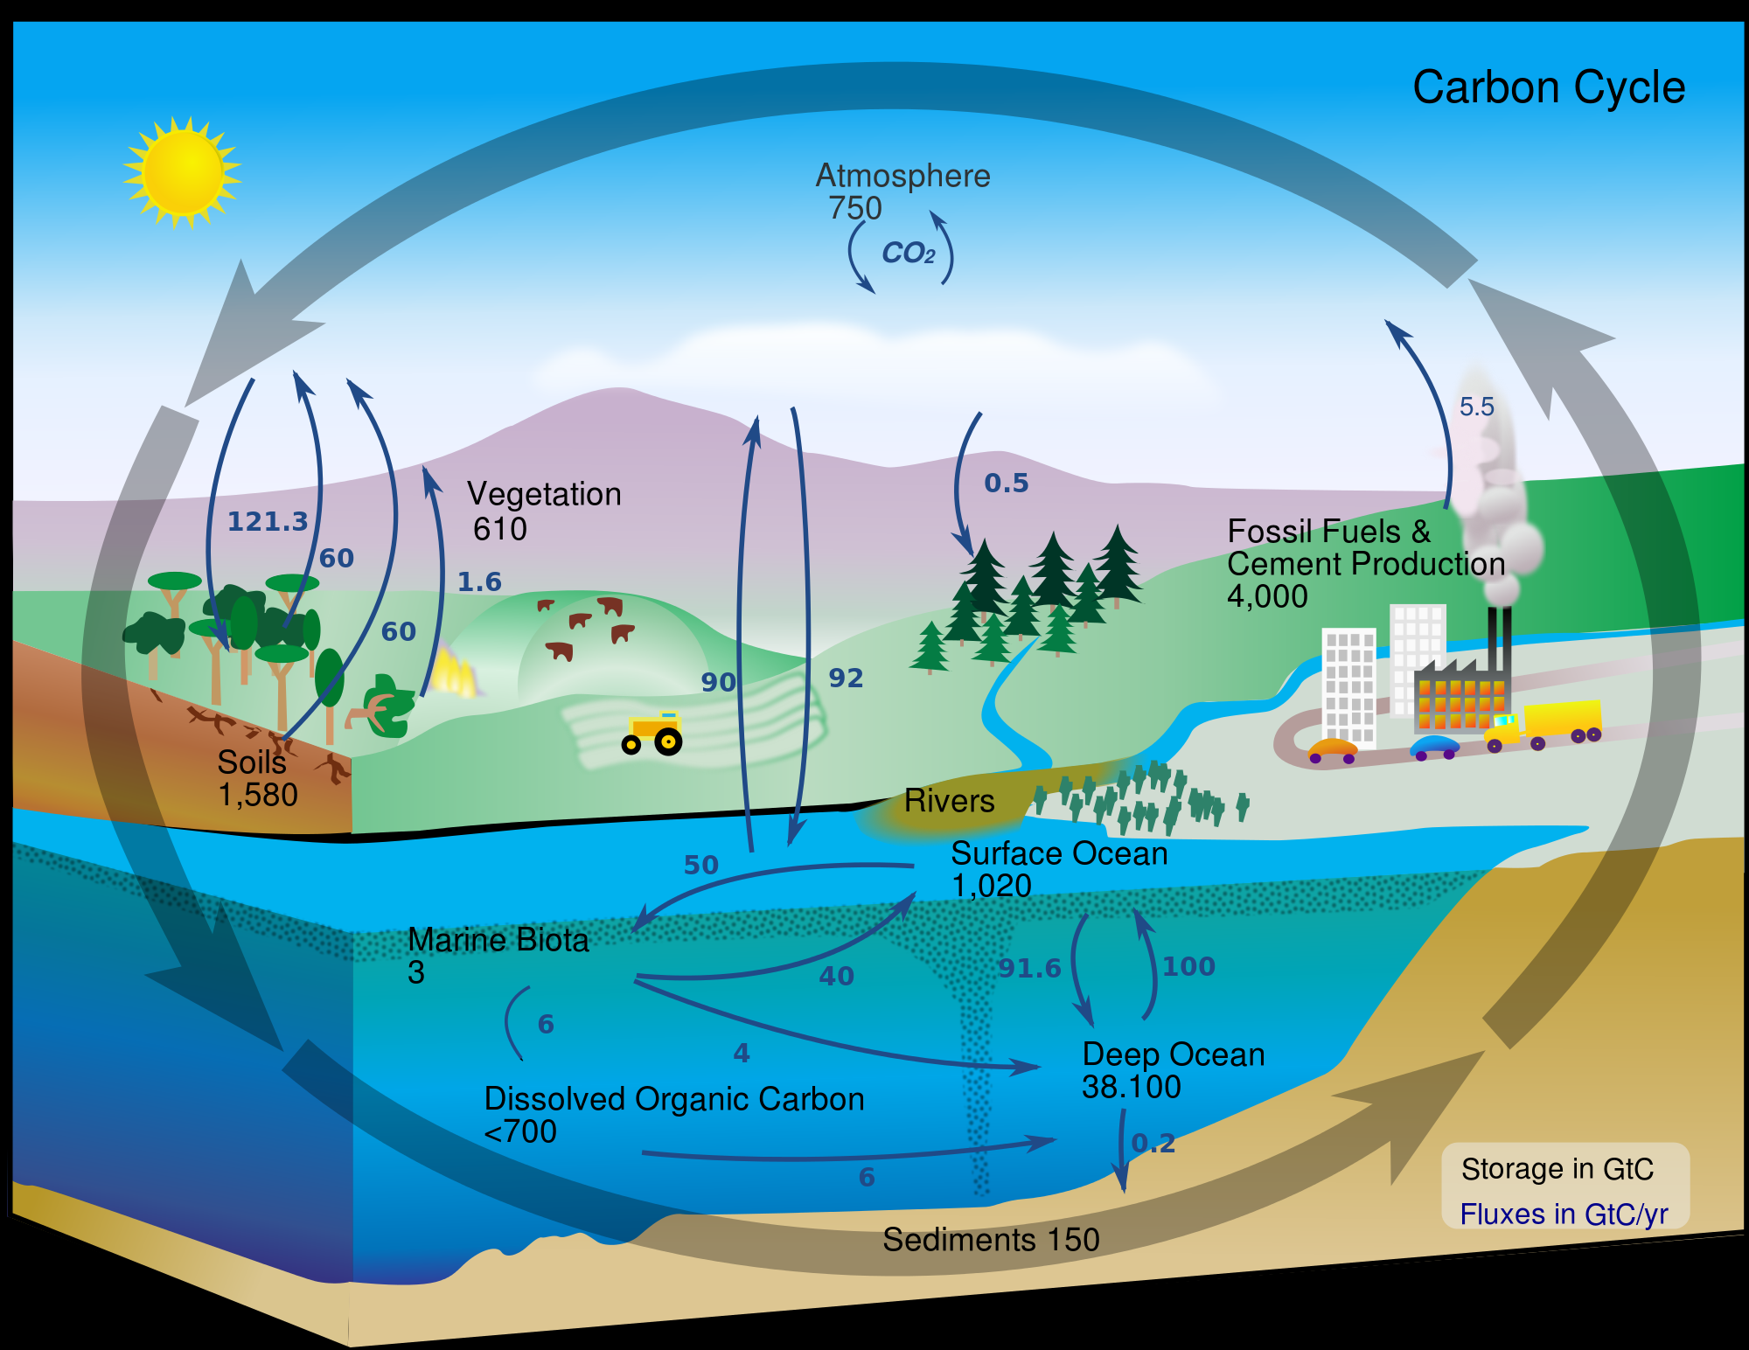
https://www.nasa.gov/centers/langley/news/researchernews/rn_carboncycle.html
Notes:
7
Carbon cycling is the natural and anthropogenic transfers and of carbon between the atmosphere, land and ocean.
Carbon sink: a store where carbon is absorbed more than it's released.
Carbon source: a store where carbon is released more than it's absorbed.
Plants are responsible for some of the major fluxes in the carbon cycle. The soil is a significant carbon store. Deep ocean burial of carbon acts as a sink, whilst forest fires and burning fossils fuels are carbon sources.

Slide 8
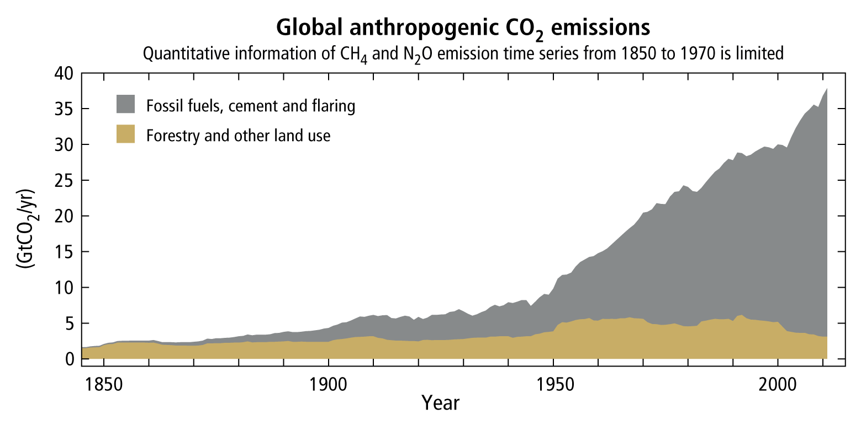
Anthropogenic carbon dioxide emissions
http://ar5-syr.ipcc.ch/topic_observedchanges.php
Notes:
8
It is important to understand the carbon cycle as human (anthropogenic) emissions of carbon dioxide are rapidly increasing... Can the system cope with the increase?
What is the impact of speeding up the long term carbon cycle?

Slide 9
Carbon Footprint
The amount of CO₂ and other greenhouse gases you are responsible for over a 12 month period
World average 4
UK average* 13.4
USA 20
Sweden, Switzerland 6.1
China 3.2
India 1.2
Tanzania 0.1
Sustainable 1.5 ?
Notes:
9
This gives us an idea of which countries are contributing to the increase in CO₂. Developed countries e.g. UK and USA release more compared to less developed countries e.g. Tanzania. China and India are interesting as they are rapidly increasing their emissions and expected to continue to do so.

Slide 10
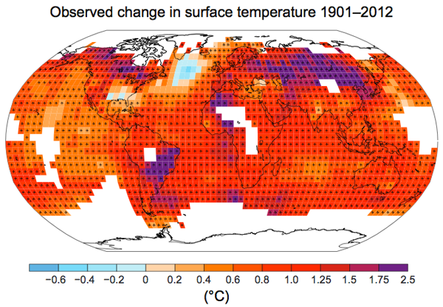
https://www.ipcc.ch/pdf/assessment-report/ar5/wg1/WGIAR5_SPM_brochure_en.pdf
Notes:
10
It is now generally accepted that the impact of increasing CO₂ levels is an increase in global temperatures (as carbon dioxide absorbs longwave radiation). This map shows observed temperature changes over the last c. 100 years with the darker reds and purples showing the larger increases in temperature and the lighter blues a decrease. Why is there an area south of Greenland that has decreased surface temperature while most places are increasing? Because of the influx of cold water which results from melting ice at the poles.
Understanding how different components of the carbon cycle will respond to warmer conditions is crucial to predicting future climate change.

Slide 11
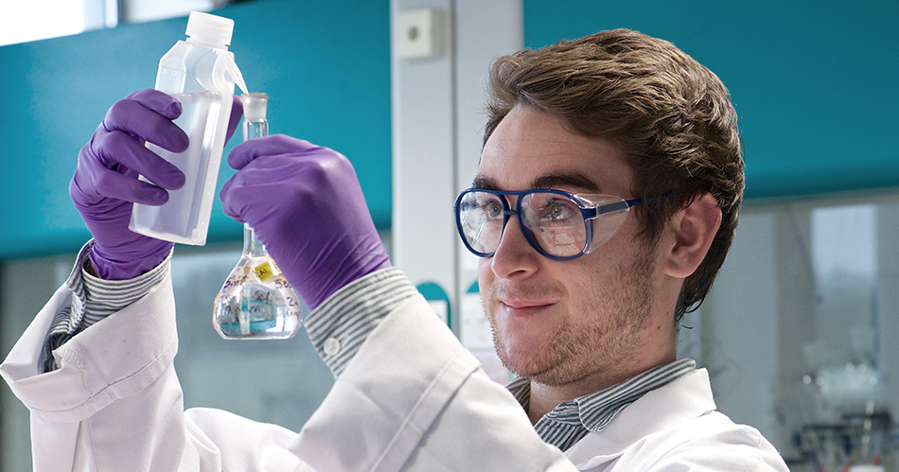
A scientific approach
Setting up an investigation

Slide 12
Geographical Enquiry
Theory
Aim
Sampling Strategy
Location
Hypothesis
Gathering Techniques
Data Collection
Risk Assessment
Data Presentation
Analysis
Results & conclusions
Notes:
This is a flowchart showing the process which should be followed when conducting fieldwork.
First, establish an aim – what you intend to achieve with your study. This will be informed by relevant theory about, in this case, the carbon cycle, so you have an idea of what you might expect to find. The specific location in which you conduct your fieldwork will affect what can be studied and what outcomes might be expected, so must be decided on at an early stage. A hypothesis can then be written – this is a testable predicative statement about your study’s outcome, which your study should be able to either prove or disprove.
Next, data can start to be collected, as long as a sampling strategy has been decided and gathering techniques considered. Before any fieldwork can be conducted, a site-specific risk assessment is required, to plan for, limit and manage potential hazards.
Once data has been collected, it can be presented clearly, through text, images, graphs, maps and diagrams, to aid its interpretation by you and any others reading your study. It can then also be analysed, by seeking out trends and anomalies. Statistical tests may be useful. Results can then be written up, and conclusions drawn. The entire process should then be evaluated. Ideally, this can be treated as a pilot study, and can then be repeated ‘for real’, with improvements.
12

Slide 13
Aim:
To investigate how carbon is cycled and stored through different ecosystems and in relation to changing temperatures.
What will happen to the amount of carbon cycled by plants as global temperatures increase?
How much organic carbon is stored in soils and trees?
Notes:
The first question is the main focus of the investigation and concerns how plants cycle CO₂ and how this may change with global warming. Will the rates of respiration and/or photosynthesis increase or decrease as temperatures change? This question concerns the ‘fast’ CO₂ cycle.
The second question involves estimating the amount of carbon stored in trees. It can also be considered by comparing the depth of the organic soil horizon in different ecosystems. It concerns the ‘medium’ cycle.

Slide 14
Linking Ecosystems with the Carbon Cycle
Atmospheric CO₂
Respiration
+CO₂
Photosynthesis
-CO₂
Plant organic matter
Notes:
14
This shows a simplified terrestrial carbon cycle. Again stores (atmosphere and plants) are in purple and processes (photosynthesis and respiration) are in red. Plants photosynthesise and respire and animals (from bacteria to you) respire.
Carbon dioxide from the atmosphere is taken and converted into organic carbon (plant) material through photosynthesis (reducing the amount of CO₂ in the atmosphere, making this a negative flux).
As plants also respire, CO₂ is released back into the atmosphere (increasing the amount of CO₂ in the atmosphere, acting as a positive flux).
This cycle is happening constantly all the time – FAST CYCLE.
Side note: Additionally, when plants die, the organic carbon from the plants becomes incorporated into the soils. Soil organic matter is then respired by organisms in the soil, producing CO₂ which goes back into the atmosphere.
In our study, we’re going to measure atmospheric CO₂ under a box, wait 20 minutes, then measure CO₂ again. We will investigate whether concentration increases or decreases (i.e. whether photosynthesis or respiration increases more).

Slide 15
Increased
Atmospheric CO₂
Atmospheric CO₂
Respiration
+CO₂
Photosynthesis
-CO₂
Plant organic matter
Notes:
15
OPTION 1: rate of plant respiration increases more than photosynthesis, leading to higher levels of atmospheric CO₂.
Higher levels of atmospheric CO₂ increases global temperatures which in turn increases rates of respiration.
i.e. positive feedback cycle leading to enhanced warming.

Slide 16
Atmospheric CO₂
Respiration
+CO₂
Photosynthesis
-CO₂
Increased
Plant organic matter
Plant organic matter
Notes:
16
OPTION 2: rate of photosynthesis increases more than rate of respiration, leading to more carbon being stored in plants (less atmospheric CO₂).
Less atmospheric CO₂ would result in a slower increase in temperature .
i.e. negative feedback, as slower rates of respiration result in less atmospheric CO₂ so slow global warming

Slide 17
Atmospheric CO₂
?
Respiration
+CO₂
Photosynthesis
-CO₂
Plant organic matter
Notes:
17
Today we will investigate which changes the most – respiration or photosynthesis.
Our study will involve using two boxes. One box will be covered, so that sunlight does not get in, meaning plants will be unable to photosynthesise, and thus sampling the CO₂ content of this box will be a measure only of the rate of respiration i.e. release of CO₂. The uncovered box will allow both respiration and photosynthesis to continue.

Slide 18
Hypothesis
Warming temperatures will decrease atmospheric CO₂ concentration due to increased rates of photosynthesis relative to plant respiration
OR
Warming temperatures will increase atmospheric CO₂ concentration due to increased rates of respiration relative to plant photosynthesis
Notes:
Therefore we have two possible hypotheses:
Photosynthesis > respiration – slow global warming
OR Respiration > photosynthesis – enhance global warming

Slide 19
Proxy studies
Measuring change over global warming time scales is difficult
We can improvise, measuring changes over temperature gradients to simulate regional warming. This is known as a proxy study
Notes:
19
Where might we be able to find a temperature gradient that exists over a small scale?
19

Slide 20
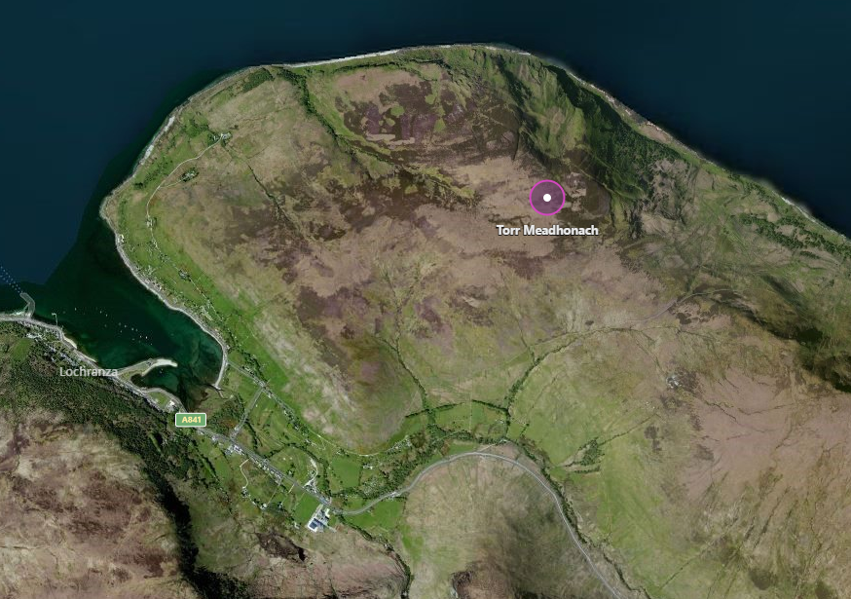
Study Site – Torr Meadhonach
N
500m
Notes:
We can find a temperature gradient by walking up a hill. The environmental lapse rate states that for every 1km you travel upwards the temperature decreases by 6.5°C (or 0.65°C for every 100m).
Therefore we can use the hill to conduct an interrupted belt transect to try and provide a temperature gradient. The issue with this might be that as we’re working through the day the air temperature may increase more than the altitude would decrease it i.e. by midday the sun is likely to be at its warmest, although this may be the time at which we reach the highest point of the hill.

Slide 21
Field Work
To be measured at each site across an altitudinal transect on Torr Meadhonach:
CO₂ flux
Air temperature
Soil characteristics
Vegetation characteristics
Climatic variables
Topographic factors
Notes:
21
At each site we will be measuring CO₂ flux and air temperature.
We will also be measuring the soil and vegetation characteristics as certain types of plants will respire/photosynthesise different amounts of CO₂ e.g. grass has a larger surface area of chloroplasts visible to the sun compared to woody plants.
Different types of soils hold different amounts of organic carbon (MEDIUM TIME SCALE CARBON CYCLE) – we will measure depth of the organic layer to be able to understand the differences between our different types of soil as we go up the hill.

Slide 22
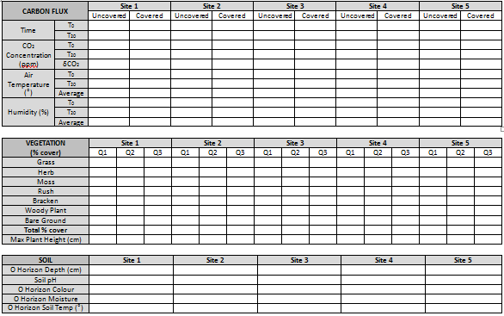
Notes:
Field sheet – find a PDF version of our field sheet under the Study Resources section of the Lochranza Centre website: www.lochranzacentre.co.uk/study-resources

Slide 23
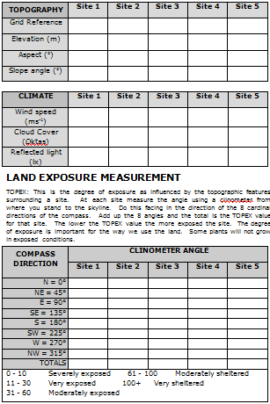
Notes:
Field sheet – find a PDF version of our field sheet under the Study Resources section of the Lochranza Centre website: www.lochranzacentre.co.uk/study-resources

Slide 24
What to do with your data and what it all means
Data analysis and interpretations

Slide 25
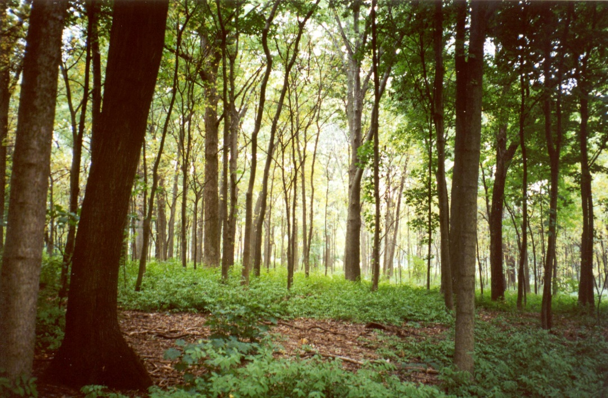
Carbon in a woodland
TREE | CBH (m) | Height (m) | Carbon Content (kg)
1
2
3
4
5
6
7
8
9
10
11
12
Total Carbon Content
Notes:
Using the table on the following slide, by taking the tree’s circumference at breast height and the tree’s overall height, it is possible to estimate the tree’s carbon content. Add the twelve carbon content weights together to generate the total carbon content of your twelve trees.

Slide 26
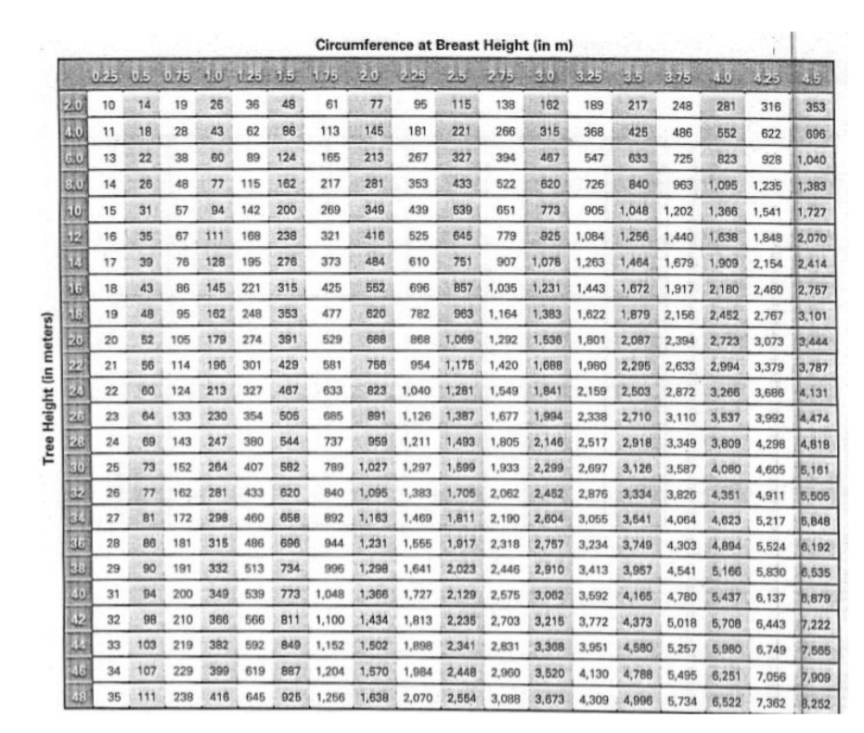
Carbon in a woodland
Notes:
Read the carbon content of your tree off this table, by looking at the tree’s circumference and height measurements. This table is also available on the field sheet, accessible from the Study Resources section of the Lochranza Centre website: www.lochranzacentre.co.uk/study-resources

Slide 27
Carbon in a woodland
TREE | CBH (m) | Height (m) | Carbon Content (kg)
1
2
3
4
5
6
7
8
9
10
11
12
Total Carbon Content
Sampling area _____________
Area of woodland _____________
Total carbon in woodland _____________
Notes:
You should have measured the area which contained your twelve trees whilst out in the field. Now, using a map of North Arran, work out the total area of the woodland in which your twelve trees were located. Divide this area by your sampling area (making sure that your areas’ units are the same), and multiply the result by the total carbon content of your twelve trees to provide an estimate of the total carbon content of the woodland.

Slide 28
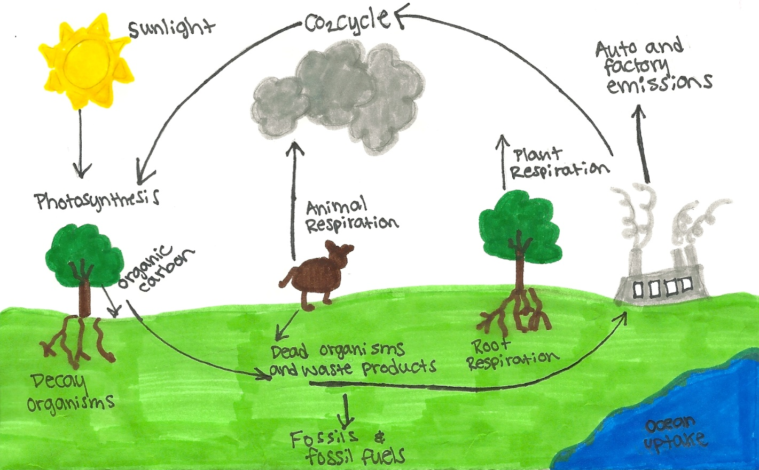
Carbon Flux
Notes:
A reminder of the fluxes involved in the carbon cycle.

Slide 29
Summary table
 |  | Site 1 |  | Site 2 |  | Site 3 |  | Site 4 |  | Site 5
 |  | U | C | U | C | U | C | U | C | U | C
Carbon Flux | Time
 | δ CO2 (ppm)
 | Net CO₂ flux (gCO₂ m⁻² h⁻¹)
 | Average Air Temp (ºC)
 | Average Humidity (%)
Notes:
29
Time = start time
δ CO2 = T20 - T0 (NB T0 refers to the results you collected at the start of your timed study; T20 refers to the results you collected at the end, after 20 minutes had elapsed)
Net flux formula is on the next slide
Average Air Temp and Humidity = mean of start and end values

Slide 30
Calculating Carbon Flux
Where:
δCO2 = CO2 T20 – CO2 T0
a = surface area of chamber (m²) = 0.15 m²
t = time of incubation (minutes) = 20 minutes
Therefore:
Notes:
30
δ = Changes in Carbon = T20 - T0
t = 20
a = 0.15m²

Slide 31
Summary table
 |  | Site 1 | Site 2 | Site 3 | Site 4 | Site 5
Topography | Grid Reference
 | Elevation (m)
 | Aspect (º)
 | Slope angle (º)
Soil | Soil temp (ºC)
 | Soil pH
 | O Horizon Depth (cm)
 | O Horizon Colour
 | O Horizon Moisture
Climate | Wind speed (ms⁻¹)
 | Cloud Cover (Oktas)
 | Illuminance (lx)
 | Exposure (total)
Notes:
31
Copy up results

Slide 32
Scattergraph for CO₂ flux versus air temperature
Net CO₂ Flux (gCO₂ m⁻² h⁻¹)
Average Air Temperature (°C)
Notes:
Plot average air temp results against net flux for both covered and uncovered boxes (two lines in different colours, and a key).
Covered box: Expect an increase in carbon flux each time as only respiration is happening. This should increase with increasing temperatures as warming temperatures are more optimal for faster rates of respiration i.e. positive flux and positive correlation. Enzyme activity slows down at lower temperatures and speeds up as temperatures increase until it reaches a maximum threshold where it’s too hot and rates slow down again.
Uncovered box: Rates of photosynthesis and respiration should theoretically continue at the same rate through the 20 minutes so change in CO₂ should be smaller. In more optimal conditions rates of photosynthesis will increase more than respiration (as the plant tries to grow). Therefore warmer temperatures will increase rates of photosynthesis i.e. negative flux and negative correlation. In more adverse conditions i.e. colder temperatures, plants will go into ‘survival mode’ meaning reduced rates of photosynthesis but continuing respiration leading to a positive flux.
There is likely to be a lot of spread around the data depending on ground, atmosphere conditions and vegetation cover.

Slide 33
Possible reasons for anomalies
Each of these factors could distort results:
The covered or uncovered box
Wet ground
Vegetation cover
Nutrients
Time of day
Notes:
Errors with the box: A poor seal may result in gases from the atmosphere escaping or entering the chamber, leading to a smaller increase in CO₂ in the covered box than expected. Error is also generated during the transfer of the gases from the syringe to the CO₂ meter.
Wet ground: Completely saturated ground leads to anaerobic conditions with a lower concentration of atmospheric oxygen. This therefore inhibits the rate of respiration and a negative flux is often recorded at these sites (think drowning plants).
Vegetation cover: The type and amount of vegetation cover will affect the rate of photosynthesis and respiration. Woody plants such as heather will have lower rates of photosynthesis compared to grass as there is a lower ‘green’ surface area. A high percentage of moss often results in a high positive flux. Moss undergoes less photosynthesis than most plants and therefore is likely to stop photosynthesising earlier than other plants, giving a longer time period of just respiration, hence the larger increase.
Nutrients: Nutrients in the ground will impact on the amount of photosynthesis occurring e.g. fertilisers in the ground near any farms.
Time of day: Later in the evening, when light levels are potentially lower, rates of respiration are much higher observed through a large increase in CO₂ levels. This is because plants do not photosynthesise during the night and are winding down in the evenings.

Slide 34
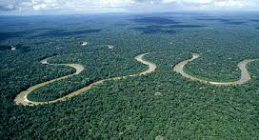
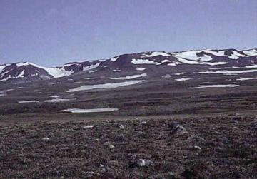
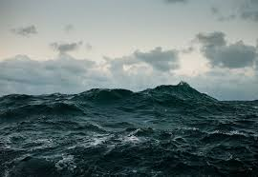
Some carbon fluxes for different ecosystems
Amazon Rainforest:
-5.9 gCO₂ /m²/h
Siberian tundra:
+0.05 gCO₂ /m²/h
North Sea:
-0.005 gCO₂ /m²/h
Recalculated from IPCC 2007
Notes:
34
Rainforest: very large sink – negative number as more is being absorbed than released
Tundra: source – positive number as more carbon is being released than is being absorbed, since lots of carbon is stored in permafrost and as temperatures are rising, permafrost is melting, and releasing carbon
North Sea: small sink – negative number as absorbing more carbon than releasing; plants in the ocean are absorbing carbon, although they also release it through respiration
Results of today's data – is the flux a positive or negative number?
Positive: releases more CO₂ than absorbs, it's a carbon source.
Negative: absorbs more CO₂ than releases, it's a carbon sink.
How has the flux differed in relation to different vegetation amounts and habitats? You can look at your data more and see if there's a relationship between carbon flux and amount of sunlight, different vegetation, or height of vegetation.

Slide 35
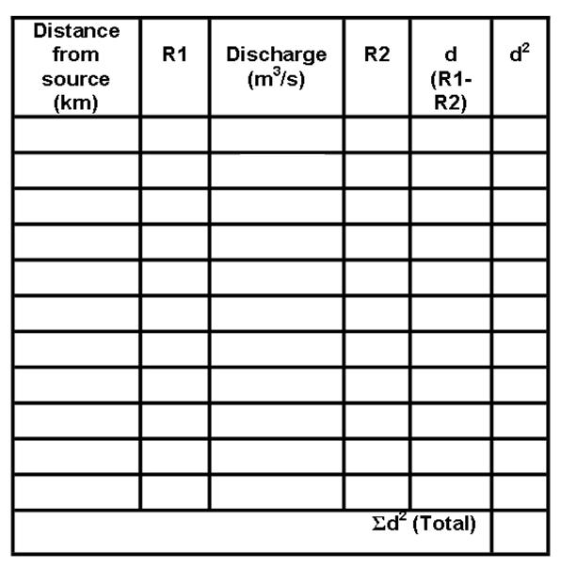
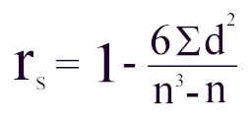
Spearman's Rank Correlation Co-efficient
No. of paired Measurements | Significance Level
 | 0.05 | 0.01
5 | 0.90 | 1.00
6 | 0.83 | 0.94
7 | 0.71 | 0.89
8 | 0.64 | 0.83
9 | 0.60 | 0.78
10 | 0.56 | 0.76
Notes:
Spearman’s is the best test for discovering a relationship between 2 variables i.e. average air temperature versus net CO₂ flux.
Spearman’s is a statistical means to testing for a relationship between two variables. First, set an alternative and a null hypothesis. Then, you can plot a correlation graph, to see whether there appears to be any relationship, and whether this correlation is positive or negative. Now, complete the table above, by ranking the two variables separately, from 1 to n (where n is the number of sites), going from lowest result to highest. R2 is then subtracted from R1 to give the difference between the ranks, and in the final column this result is squared (which cancels out any negative signs). Total up the d² column, and then use the formula to obtain r_{s}, the Spearman’s rank correlation co-efficient. If your result is greater than the significance level at 0.05 for your number of paired measurements, you can accept your result as 95% significant, and reject the null hypothesis; if it is greater than 0.01, you can accept it as 99% significant. Your result should be between -1 and 1, with -1 indicating a perfect negative correlation between the two variables, and 1 indicating a perfect positive correlation. The closer the result is to 0, the less closely related the two variables are. Finally, write a conclusion about whether you can reject or accept your hypothesis, and explain the result of this statistical test.
Ideally need ten data sets; you can use some data from the long term data file, available from the Study Resources section of the Lochranza Centre website: www.lochranzacentre.co.uk/study-resources
35

Slide 36
Notes:
Data can be plotted as located data. Keep scales the same for each graph across sites to allow for easy comparison. This data can help to explain anomalies in results.

Slide 37
Soil Depth
Notes:
Zero is at the top of the scale! Plot depth of O horizon, and colour in to best match the soil colour.

Slide 38
Radar Diagram
 | Min | Max
Wind Speed
Relative Humidity
Soil pH
Depth of Top Soil
Soil Temp
Air Temp
Notes:
Work out range for each factor across all sites and devise suitable scales for each factor.
Plot result on for each factor, join points up, and shade the enclosed area.

Slide 39
Pie Chart
° = number in each category x 360
total number
Notes:
A pie chart indicating vegetation cover.

Slide 40
Bar chart
Notes:
Bar chart for maximum height of vegetation, indicated either by a bar or an illustration of the plant to fit the scale.

Slide 41
Kite Diagram
Notes:
Kite diagram for percentage cover grass. Plot the percentage grass cover for each site you studied, noting its height above sea level on the x-axis below. For a kite diagram, your data is mirrored; shade the area enclosed for a clear representation of how grass cover has changed along the transect with height above sea level.

Slide 42
Questions
Where is the most organic carbon found?
What abiotic factors are most suited to the formation of more organic carbon?
What types of plants are found in areas with larger amounts of organic carbon?
Notes:
These questions consider the organic carbon stored in soils.
The most organic carbon should be found at the top of the hill in the heathland area, close to the peat cuttings.
An abiotic factor which encourages the formation of organic carbon is temperature: when it is colder there will be a slower rate of decay which is conducive to organic carbon formation.
Moss is common in a heathland, and as it is compressed over time will form peat.

Slide 43
Evaluation of Techniques
Technique | Advantages | Disadvantages | Justification | Improvements
Notes:
Which techniques (methods, pieces of equipment, or sampling strategies) worked well in the study? Consider what worked, what didn’t, why on balance the method you used was appropriate, and what could be changed for a more effective study. This is an important part of evaluating any geographical enquiry process.

