Slide 1

GEOLOGICAL investigation SKILLS
Skills
Notebook Setup
Rock Descriptions
Field Sketches
Quantitative Data
Sampling Strategies
For further information, see the ‘Notes’ section of the PowerPoint

Slide 2
Required skills
Location of a Geological feature in the field
Identification of a geological features , recording observations as field sketches
Use of a compass clinometer
Construction of a graphic log
Use of sampling techniques
Production of full rock descriptions
Use of methods to increase accuracy (fiducial scale)
Additional Skills
Application of classification systems
Production of annotated scientific drawings of fossils
Use of Photomicrographs to identify minerals and rock textures
Use of physical and chemical testing to identify minerals

Slide 3
SETTING UP A FIELD NOTEBOOK
What to write and where?

Slide 4
Useful things
Name
School
Contact Details
Page Numbers
Contents Page

Slide 5
Layout- before you go
Title
Date
Overall aim of the day
Weather
Location Data
Quantitative Data
Mood
Dip/strike
Bedding
thickness
Hazards
Qualitative Data

Slide 6
Layout- when you get there
Stop 1-
Description of location and outcrop using key features e.g. House names
Grid Reference
Any changes in weather, mood and site specific hazards
Location Data
Aims at specific site location
Now we are ready to describe the rocks. Useful tip can be to use headings and subheadings to separate out the notebook and keep it tidier

Slide 7
Layout- observations
Stop 1-
Site Introduction
Grid Reference
Macro Observations
How many rock types? Contacts?
Colour
Bedding? Is it? What scale?
Tectonic Structures
Sedimentary Structures/Features
Other notable features
Key Question: Granular or crystalline?

Slide 8
Layout- observations
Stop 1-
Site Introduction
Grid Reference
Macro Observations
Micro Observations
Sedimentary:
C S
C S
C S
Igneous/Metamorphic:
C S
C S
T
Be specific as possible and use crib cards

Slide 9
Layout- observations
Stop 1-
Site Introduction
Grid Reference
Macro Observations
Micro Observations
Field Sketches
S
N
O
T
Camera picture number
Useful for synthesising both macro and micro observations

Slide 10
Layout- observations
Stop 1-
Site Introduction
Grid Reference
Macro Observations
Micro Observations
Field Sketches
Interpretations
Sedimentary:
Energy, environment, direction
Igneous:
Composition, intrusive/extrusive, cooling rate, direction
Metamorphic:
Protolith, deformation history, burial depth
Overall geological history

Slide 11
SEDIMENTARY ROCK DESCRIPTIONS
C
C
C
S
S
S

Slide 12
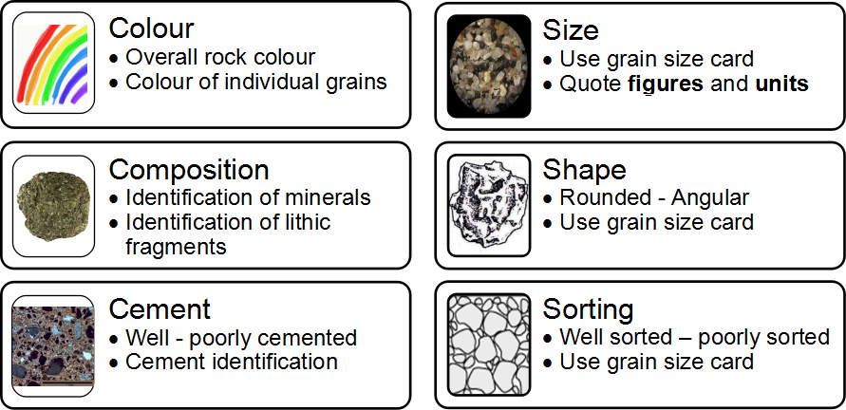
Micro Descriptions

Slide 13
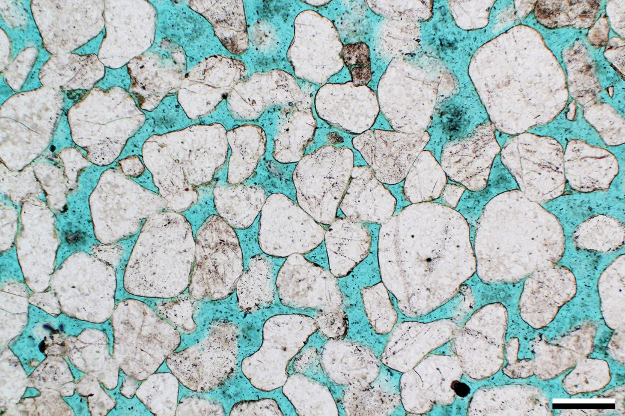
Notes:
Mid. Jurassic Entrada Fm., Uintah Co., Utah
A supermature sandstone that meets all aspects of the definition of that textural term. It lacks any clay matrix and consists of very well-sorted and very well-rounded quartz grains. This sandstone is eolian—a depositional environment, which is most commonly, but by no means exclusively, associated with deposition of supermature sandstones. As in most such deposits, it is also compositionally mature with virtually nothing but quartz present as a result of mechanical, and perhaps also chemical, degradation of other, more unstable minerals
PPL, BDI, Scale bar = 0.26 mm

Slide 14
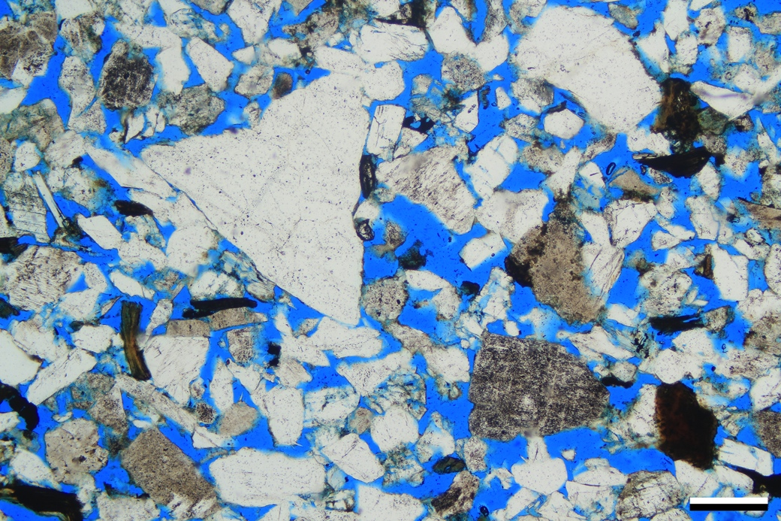
Notes:
Unknown unit, unknown U.S. location
Having covered the textural maturity grades that involve interpretation of matrix, we will now look at the more mature categories. This is submature sandstone; grains are generally very angular and poorly sorted, and the rock contains substantial primary and minor secondary porosity, but no clay matrix. Recognizing textures in uncemented or largely uncemented sandstones is far easier than in cemented ones, especially where porosity is impregnated with dyed resins because the shapes and sizes of grains are starkly silhouetted against a colored backdrop.
PPL, BDI, Scale bar = 0.34 mm

Slide 15
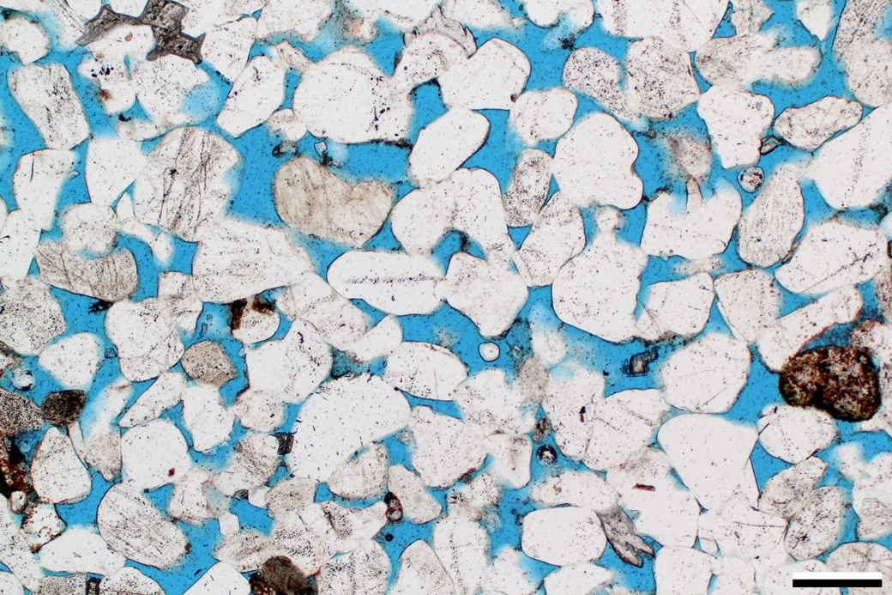
Notes:
Mid. Jurassic Entrada Fm., Moffat Co., Colorado
An example of a feldspathic quartzarenite with mainly primary intergranular porosity (about 24% total porosity based on image analysis). The primary porosity has been reduced slightly by quartz overgrowths and minor kaolinite and dolomite cementation along with minor compaction (note close grain packing in some areas).
PPL, KFS, BDI, Scale bar = 0.26 mm

Slide 16
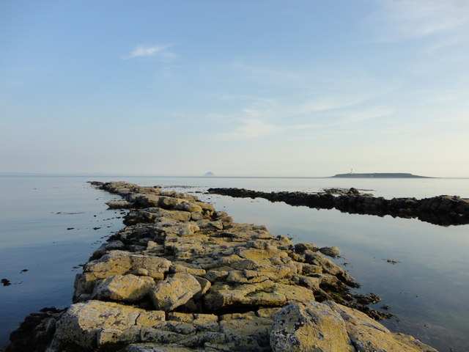
IGNEOUS ROCK DESCRIPTIONS
C
C
S
S
T

Slide 17
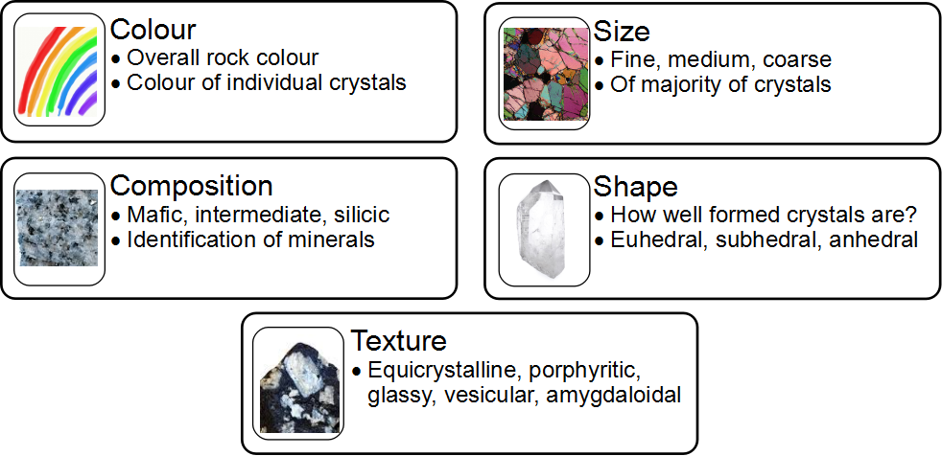
Micro Descriptions
Ophitic

Slide 18
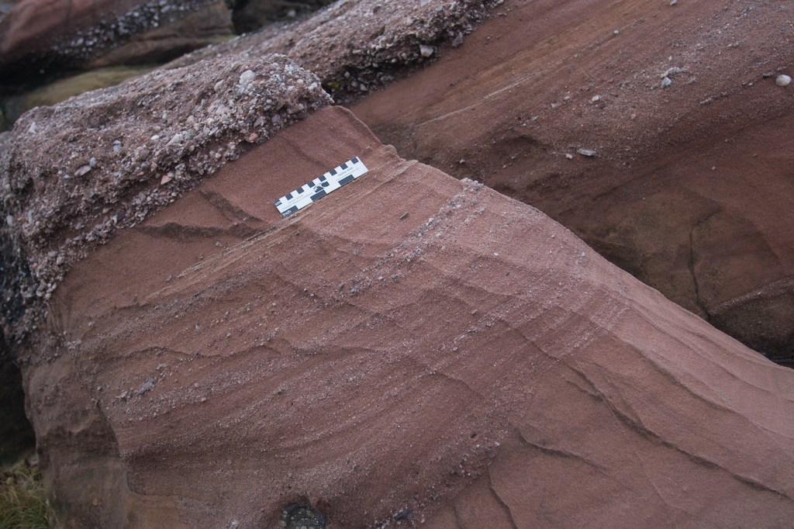
FIELD SKETCHES
TONS of SNOT

Slide 19
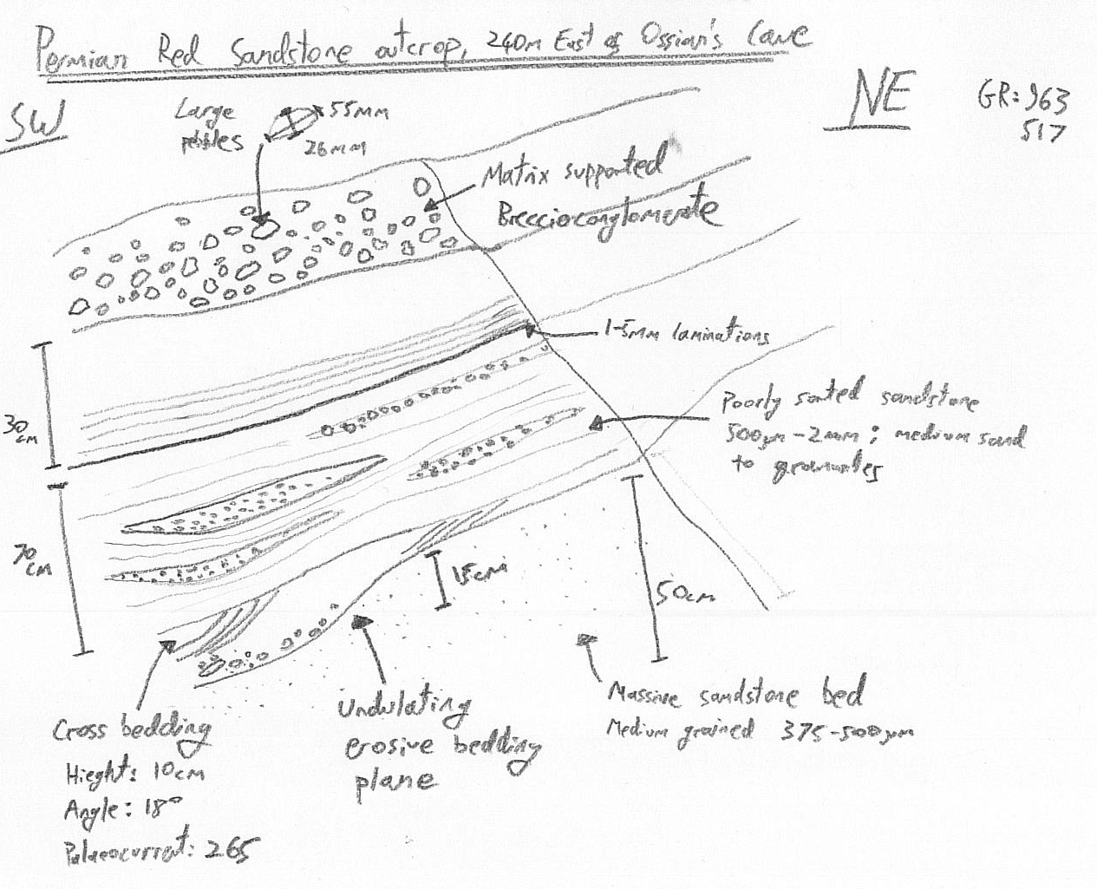
Title
Orientation
Notes
Scale

Slide 20
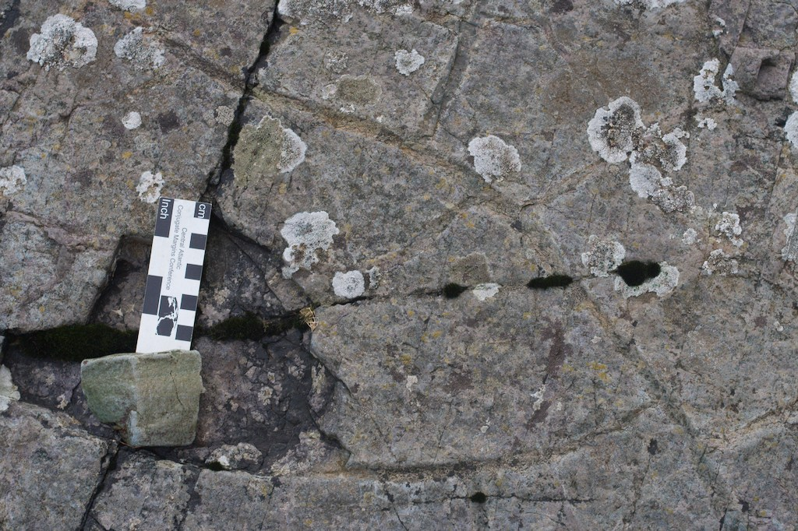
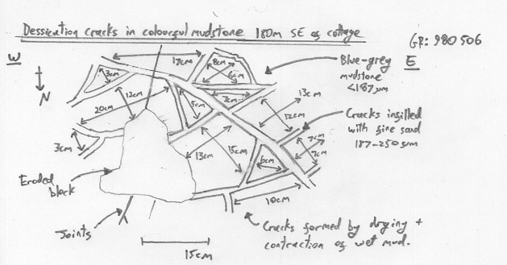
Take sufficient precise measurements of one type of sedimentary structure to form a representative data set & include appropriate measurements on your field sketch
Notes:
20

Slide 21
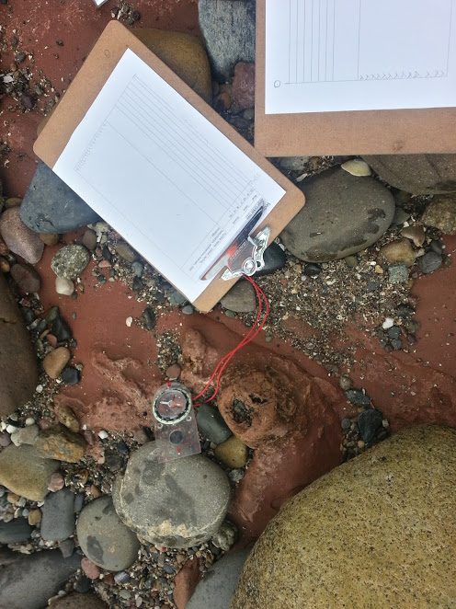
QUANTITATIVE DATA
Dip and Strike
Dyke Measurements
Sedimentary Logging

Slide 22
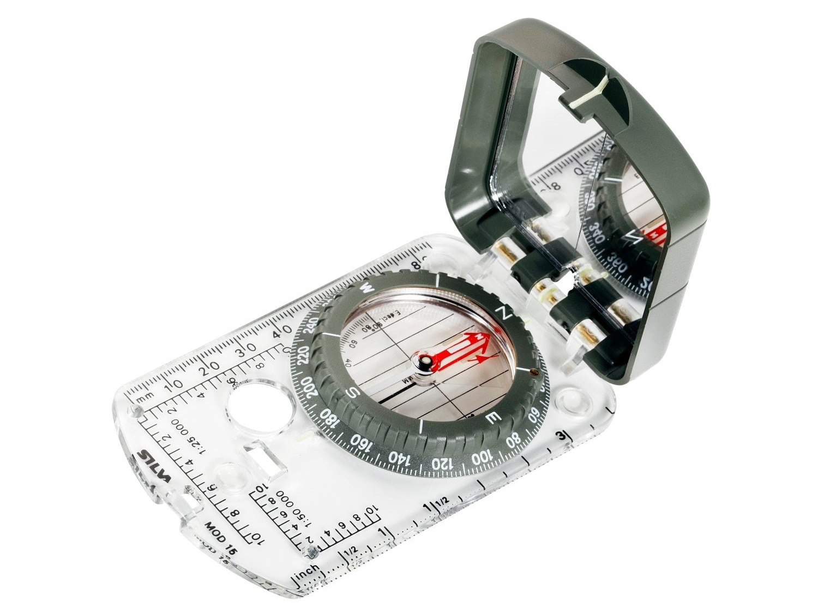
Dip & strike workshop
Notes:
22

Slide 23
Bedding plane
Break in sedimentation
Change in composition or grain size
Change in the colour
Dip
The maximum inclination of a bed
from horizontal
An angle measured using a clinometer
Strike
The direction at right angles to the dip
There is zero dip in this direction
A bearing measured using a compass
Notes:
23

Slide 24
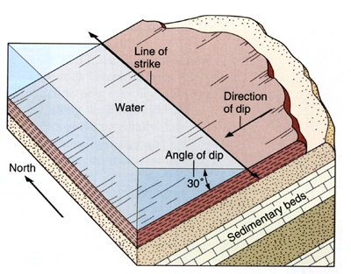

Slide 25
Set compass to West-East
Find the strike line- where inclination (dip) is 0 and draw onto rock
Draw tick at 90° in direction the plane is dipping
Use Right hand rule, palm of hand on surface, thumb pointing down dip
Take bearing along the strike line in direction of fingers and record to 3 digits. Keeping compass horizontal
Reset compass to West-East
Measure dip angle using inner clinometer scale and record to 2 digits
Take the direction that the plane is dipping and record as cardinal points
Record measurement as STRIKE/DIP ANGLE/DIP DIRECTION e.g. 042/14/E

Slide 26
Sedimentary
Logging
Calculating true thicknesses and plotting

Slide 27
Calculating true thickness
Outcrop width
Straight line approximating horizontal
Dip Angle
Outcrop width
True thickness
SOHCAHTOA
Hypotenuse
True thickness
Opposite
SOHCAHTOA
Dip Angle
Adjacent
Sinθ= O/H
O= H x sinθ
True thickness = outcrop width x sin dip angle

Slide 35
DYKE MEASUREMENTS
What measurements to take?

Slide 36

Dyke measurements
1
2
3
4
5
6

Slide 37
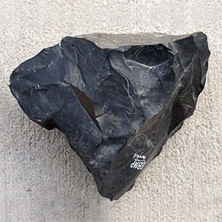
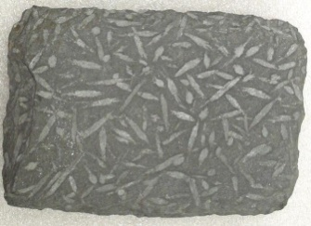
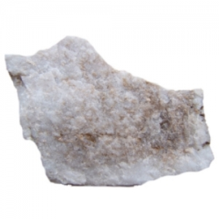
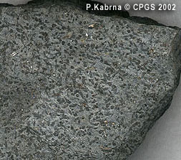
Factors affecting baked margins
Recrystallization
Hornfels
Andelusite Slate
Spotted rock
Red to green
Sandstone
Mudstone
Notes:
Arrows point to the Baked margin
Baked Margin Characteristics:
Contact Metamorphism of Mudstones
Chemical compositions of minerals in shale is varied and so a range of metamorphic rocks are produced, depending on temperature and distance from intrusion.
Close contact – Hornfels – High temperatures therefore high grade metamorphism occurs. Hornfels is a fine grained, hard, splintery, granoblastic rock.
Intermediate distance from contact – Andelusite Slate – heat is less intense, medium grade. Has a high content of the metamorphic mineral andalusite
Further away – Spotted Rock – lower temperature, some recrystallisation.
*General gradation from hornfels back through to the original country rock.*
Baked Margin of Sandstone
Become lighter – haematite on Permian Sandstone becomes unstable and no longer provides the red colouration.

Slide 38
Identifying chilled margins
Crystal size?
Cooling joints spacing?
Colour?
Erosion?
Notes:
Chilled Margin:
Definition: where the igneous rock has cooled rapidly so it has fine crystals.
Chilled Margin:
Edge of igneous intrusion, which is closest to the cold country rock
Cools faster
Finer crystals
Densely pack cooling joints – faster cooling therefore more contraction cracks
Less resistant – more cooling joints for weathering to occur
Can be only few cms to ms wide.

Slide 39
SAMPLING STRATEGIES
Choosing what to study

Slide 40
What is a sample?
Population = Everything
Sample = A selection of everything
A good sample should be:
Large enough to get meaningful results and carry out necessary statistical tests
Unbiased
Representative of the whole population
Notes:
Consider:
Time
Cost
Knowledge
Accurate
Repeatable
Reliable

Slide 41
Mean = the “average” of a set of values, calculated as Sum of the Values divided by the total number of values
Mode = The most commonly occurring value
Median = The middle number when values are in order
standard dev = the amount of variation in a data set
normal distributions = the area under a graph of data

Slide 42
Sampling Techniques
Sampling by Opportunity – available at the time
Systematic Sampling – at regular intervals
Random Sampling – uses random numbers
Stratified Sampling – each subpopulation is sampled independently
+
-
+
-
+
-
+
-
Notes:
Population refers to all the data available, for example a census collects data from a whole population.
A good sample has the following qualities:
Unbiased
It is precise i.e. it provides an accurate estimate of the population.
Large enough to provide conclusive results in terms of statistical significance.
Can be collected easily wit the minimum of resources.
Sampling by opportunity – quick and easy, however not reprehensive.
Systematic – Samples are chosen in a systematic, or regular way. Regularly distributed in a spatial context e.g. Every 20m, regular intervals in a temporal context e.g. Every 30mins, or regularly numbered e.g. every 10th house.
Advantages: Disadvantages:
-Straight forward and easy to carry out -More biased as not all member or points have an equal chance of being selected
-Good coverage of study area can be easily achieved
-Can cover a large area -Can lead to an over or under representation of a particle pattern.
Random – can use a random numbers table
Advantages: Disadvantages:
-Can be used with a large sample.
-Avoids bias each member of the sample have equal chance of being selected/ no subjectivity. -Can lead to a poor representation of the sample if an area is not hit by random numbers table.
-Produces large samples therefore time consuming.
Stratified – Used when parent population or sampling frame is made up of sub-sets of know size. These sub sets make up different proportions of the total there sampling should be stratified to ensure that results are proportional and representative of the whole.
Advantages: Disadvantages:
-If proportions of the sub-sets are known it can generate results which are more representative -Sub-sets must be known accurately
of the whole population for it to work correctly
-It is very flexible and applicable to many geographical enquires.
-Correlations and comparisons can be made between sub-sets.
42

Slide 43
Transects
A line of investigation to identify spatial changes in variables
Line Transect
Study along a straight line from one point to another
Belt Transect
As above but widening and continuous in a unbroken manner
Interrupted Belt Transect
Defined intervals
Notes:
Line transect: usually done over a short distance.
Belt Transect: Only over a short distance as time consuming.
Interrupted Belt Transect: Good for long distances.
43

